Slide 1
HIVE Leadership Program
Resourcing Reproductive Health, Rights & Justice Work in Louisiana
Monday, October 30, 2017

Slide 2
CONVERGE
is a values-based consulting firm whose mission is to accelerate the creation of a radically just new world where communities of color thrive.

Slide 3
Objectives
To provide HIVE leadership development program participants with:
A contextual understanding of current trends in philanthropic support for social justice work in the Deep South;
A deeper analysis of how to generate resources to sustain reproductive health, rights and justice work in Louisiana in the current political environment.

Slide 4
Agenda
Welcome and Introductions
Resourcing Social Justice Work: An Overview
Philanthropic Support of Reproductive Health, Rights and Justice Work
Lunch
Small Group Strategy Sessions
Large Group Discussion
Reflection and Wrap-Up

Slide 5
Resourcing Social Justice Work: An Overview

Slide 6
Who Gives?
$390 Billion in charitable contributions made in the U.S. in 2016.
$281 Billion comes from individuals

Slide 7
To What Causes?
$390 Billion in charitable contributions made in the U.S. in 2016.

Slide 8
Characteristics of Funding Sources
 | Government | Foundations | Corporations | Individuals
Purpose | Public/political good | Foundation mission | Corporate brand | Individual
Concerns | Accountability | Impact | Marketing/ Branding | Psychology/ Emotion
Funding Tools | Grants, Contracts | Grants | Grants, Sponsorships | Individual gifts
Uses | Mostly programmatic w/ limited overhead Some capital | Mostly programmatic, but can include advocacy, capacity-building, capital, etc. | Mostly programmatic w/ limited overhead | Flexible
Pros | Larger amounts Stable across years | Can be larger amounts Renewable in short-term Can be multi-year | Usually annual Can have few line item restrictions | Least restricted Can have quick turnaround Sustainability
Cons | Often technical Requires org. capacity Slow to access Administrative burden Subject to political whims | Usually lasts 3-5 yrs max Rarely rapid response Driven by program design and outcomes | Often seeking large reach / audience | Requires high investment for low short-term financial return
Risk Tolerance | Low | Medium | Low | Low - High
Notes:
What would you add?

Slide 9
The 72%: Individual Giving
Who Gives by Background?
Most people give from their earnings. 90% of gifts come from earnings, not assets.
African-Americans are more generous. African-American people give away 25% more of their income per year than White people.
Poor people are more generous. Americans living below the poverty line are more likely than others to give more than 10 percent of their income to charity.
The rich aren’t the most generous. Middle-class Amer­i­cans give a far bigger share of their discretionary income to charities than the rich. Households that earn $50,000 to $75,000 give an average of 7.6 percent of their discretionary income to charity, compared with an average of 4.2 percent for people who make $100,000 or more.
Economic diversity matters. Rich people who live in neighborhoods with many other wealthy people give a smaller share of their incomes to charity than rich people who live in more economically diverse communities.

Slide 10
The 72%: Individual Giving
How Old Are They?*
People over 45, on average, have 5 charities that are “theirs” and that they give to regularly.
Generation X, on average, gives $756 dollars per year – have no idea that their total is that big – and support over 10 organizations, of which they can name 2. But they can name every friend who linked them to a gift they don’t remember making.
*Based on 2012 information from the Grassroots Institute for Fundraising Training.

Slide 11
Individual Giving in the Region
The Chronicle on Philanthropy used 2015 Internal Revenue Service data on itemized charitable giving to create a snapshot of giving in every county and metropolitan area in the country. (Only donations of taxpayers who took a deduction are included, so these data reflect higher income donors.)
New Orleans Metropolitan Area
Population: 1.2 million
Average Giving per Itemizer: $5,570 (21st of 50 largest metros)
Average Percent of Income to Charity: 3.1% (21st of 50 largest metros)
Total in Itemized Contributions: $600 million
Middle Class Giving: People who earned $50,000-$75,000 gave away 4.6% of their income – above the 3.8% national average for large cities and better than almost two-thirds of its peers.

Slide 12
Foundation Giving in the Region
$58.5 Billion in charitable contributions made in the U.S. in 2016.
Total Per Capita Grantmaking, 2010-2014
Southern Louisiana*
Louisiana
United States
New York State
Orleans Parish
New York City
*Outside Baton Rouge & New Orleans
June 13th, 2017

Slide 13
Foundation Giving in the Region
Percentage of Total Grantmaking Focused on “Underserved Communities,” 2010-2014
Southern Louisiana*
Louisiana
Orleans Parish
*Outside Baton Rouge & New Orleans
June 13th, 2017

Slide 14
Foundation Giving in the Region
Percentage of Total Grantmaking Focused on “Systems Change,” 2010-2014
Southern Louisiana*
Orleans Parish
Louisiana
*Outside Baton Rouge & New Orleans
June 13th, 2017

Slide 15
Philanthropic Support for Reproductive Health, Rights & Justice

Slide 16
Common Language
Reproductive oppression is the control and exploitation of women, girls, and individuals through our bodies, sexuality, labor, and reproduction. The regulation of women and individuals thus becomes a powerful strategic pathway to controlling entire communities. It involves systems of oppression that are based on race, ability, class, gender, sexuality, age and immigration status.
Reproductive Health is a service delivery model, which addresses the reproductive health needs of women. It focuses on lack of healthcare, services, information, as well as research and health data. The goals are to improve and expand services, research and access, particularly in prevention, and provide culturally competent care for communities of color.
Reproductive Rights is a legal and advocacy-based model that serves to protect an individual woman’s legal right to reproductive health care services. It addresses the lack of legal protection or enforcement of laws implemented to protect an individual woman’s legal right to reproductive health care services. The goal is to have universal legal protection for all individuals and claim these protections as constitutional rights.
Reproductive Justice is a movement-building framework that identifies how reproductive oppression is the result of the intersections of multiple oppressions and is inherently connected to the struggle for social justice and human rights. A woman’s societal institutions, environment, economics and culture affect her reproductive life.

Slide 17
 | Reproductive Health | Reproductive Rights | Reproductive Justice
Analysis | Lack of access to services | Protect women’s individual rights to reproductive health care services | Interconnecting social justice and human rights issues impact women’s self-determination
Strategy | Improve and expand reproductive services | Policy advocacy and litigation strategies, statewide coalitions and alliances | Building power and social movement through community organizing and leadership development of the most marginalized women and girls
Constituents | Patients | Women as advocates | Women and their communities
Key Players | Healthcare providers | Advocates, legal experts, policymakers, and elected officials | Social justice organizers
Challenges & Limitations | Individual level, does not address root causes, resource intensive | Rooted in neoliberal notion of individual choice, assumes access to and belief in the political system | Requires significant investment of resources into building constituent power
Based on A New Vision for advancing our movement for reproductive health, reproductive rights, and reproductive justice by Asian Communities for Reproductive Justice (now Forward Together). 2005. http://strongfamiliesmovement.org/assets/docs/ACRJ-A-New-Vision.pdf

Slide 18
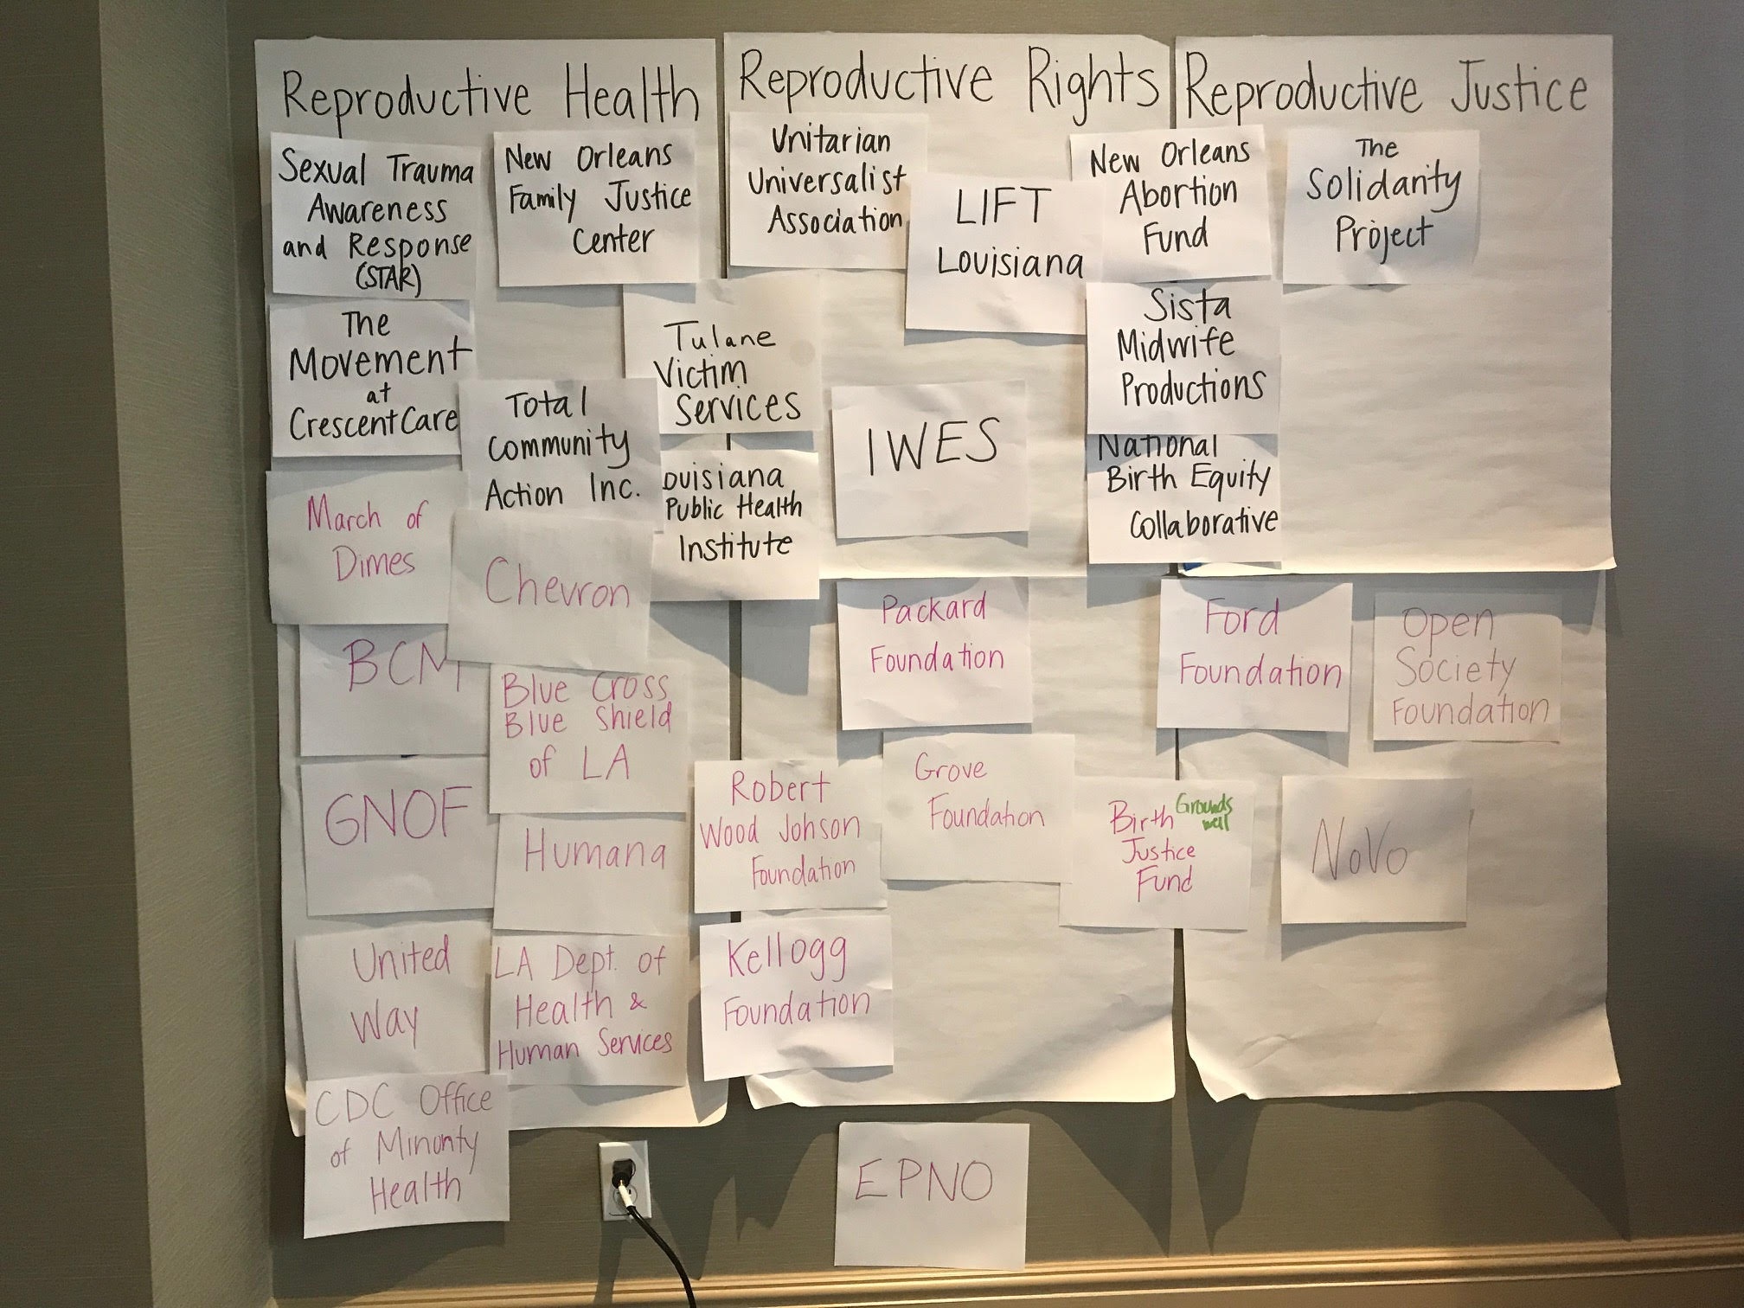
Map

Slide 19
Closing Reflection
What is one lesson or new way of thinking I am taking away from this session?
What is one next step I will take to develop my ability to resource my work more effectively?

