Slide 1

Welcome!
Fundraising Bright Spots
Making Fundraising Work for Your Organization

Slide 2

Introductions
Please pick a quote (slips of paper) that expresses a core value for you.
Share your quote with your pair, and with someone you do not know yet.

Slide 3

What are You Bringing to Our
Learning Community?
How are you today?
Share your fundraising superpower, the quote you chose, and how you like to contribute to and learn in groups.

Slide 4
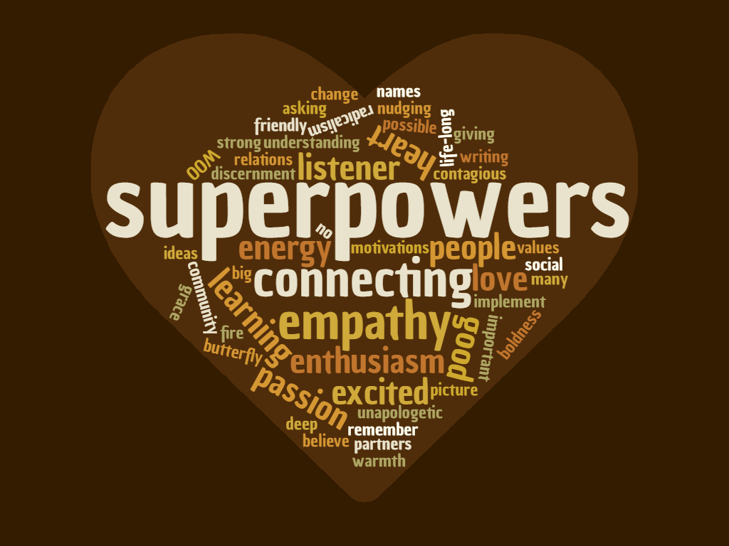

Slide 5
Creating New Actions
culture
systems
skills

Slide 6
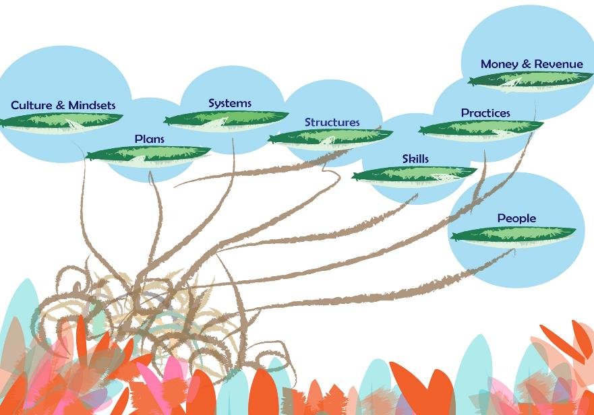

Slide 7
Taking Action
Continue the analysis you start in each session.
Bring content, learning and next actions back.
Try on, Increase ownership and alignment

Slide 8
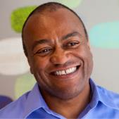
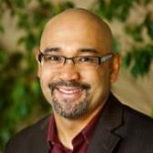
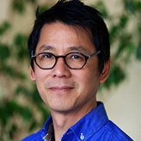
Program Advisor & Coaches!

Slide 9
Communication & Learning Agreements
What do you need in order to fully participate and learn in this setting?

Slide 10
Today’s objectives
Begin to establish a learning community; learning about our individual and collective strengths and talents.
Create a baseline understanding of how fundraising happens in your organization.
Understand the fundraising bright spots mindsets in the four theme areas.
Explore how fundraising is core to your organizational identity.
Begin to assess alignment of your fundraising activities to your current revenue model.

Slide 11
Map Out Current Fundraising Actions & Activities
Category | All activities in the year
Identifying new supporters | Grant research Name generation Two house parties Quarterly open house/tours
Cultivating giving relationships | Hot topic gatherings 1:1 reach outs Email updates
Asking | Spring appeal & house parties 20 major gift meetings Annual event Give Out Tuesday Fall appeal EOY
Recognition & Thanks | Letters Phone calls to gifts above $500
Stewardship: loyal donors | 1:1 reach outs donor email updates

Slide 12
What do you do?
Ignatius
Shria
Azzi
Tanya
Jose

Slide 13
Name Systems
& Who Contributes
Social media: Facebook, Twitter
Website content and donor interface
Donor Relationship Management
Email service

Slide 14
What are you both seeing in your map?
What did you each see/emphasize differently?
Areas of strengths and weakness?
Gaps in actions?
Bright Spots to learn from?

Slide 15
Changing Mind Sets
Core to Groups Identity
Distributed Broadly Across Group
Authentic Relationships
Diligence in Systems

Slide 16
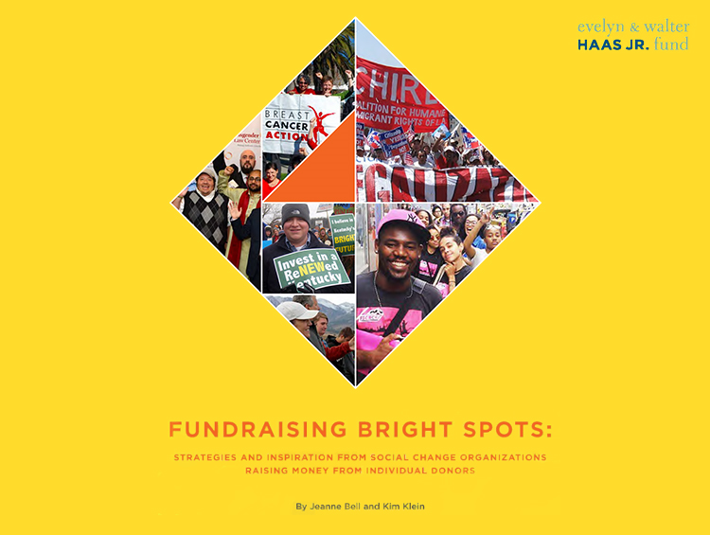

Slide 17
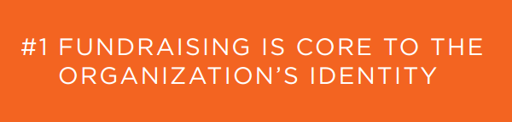
Notes:
The Bright Spots started with a fundraising philosophy that permeated their organization. Fundraising was never separate from anything else they did.
People are attracted to your mission—we hear a lot of talk about being “Donor Centric” but in the Bright Spots, all the donors are invited to be vision-centric and they carry the vision to their networks.

Slide 18
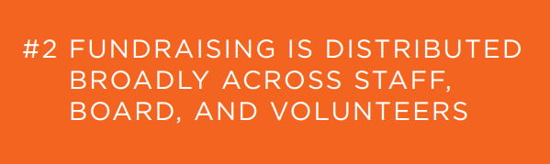
Notes:
How many people here have worked several years as a development professional? Anyone that has held this as their primary work identity more than a decade?
Development knowledge – how did you gain development knowledge?
(fundraising and making mistakes, reading, going through intensive training, certification CFRE, being in close contact with Development peers or mentors)
Development staff are hired for their knowledge, experience and track record.
Many of us come from within the org, pushed in, or growing into the job.
Bright Spots groups (Many did not have a Development Director) used their development positions to activate and move development actions through the year, with staff, volunteers, board members.

Slide 19
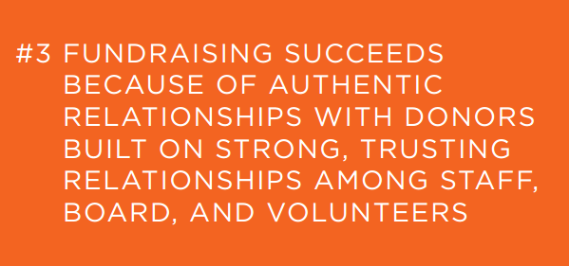
Notes:
Steve Leads:
What are authentic relationships?
For me, they are getting a very current understanding of what the donor is feels good about, is excited about, and what the organization is actually doing. If the organization is going in a different direction from what some donors supported in the past, we ask is this something you want to support? When I made calls for GIFT giving campaigns, I did my best to keep the giving current, rather than pulling on the past.. I also learned more each time about why the person I was speaking to was giving. This is good stewardship of a relationship with ongoing supporters.
Ask again, what do authentic relationships with donors mean to you?
Examples from Bright Spots:
Bright Spots groups did not trash talk their donors. Of course they were on their good behavior, but something usually slips when people are in the habit of being disrespectful to donors.
They also do not aim to have everyone be a donor or to remain a donor as time passes. At the Crossroads example: On their street tours they are not looking to impress the donor with success stories, because homeless youth that they work with are living in survival situations- the street tours are what they are...
We also get into situations where we know there are real differences in power- a donor who has given a lot and may not be aligned to what we are actually doing. We may get triggered by things they say if they are understanding our work differently than what we actually do. Charity vs. solidarity, class differences, young people asking much older donors, people of color asking white donors…
Exercise in small groups: Do you like your donors? (Some more than others, obviously, but overall, are you happy to know them?) Do you look forward to reaching out to them? What would make you like them more? What needs to change in your fundraising for you to have more authentic relationships with donors?
Discuss also dealing with Power issues, what is the role of race and class in keeping us from having authentic relationships?
Kim: Bright Spots groups did not trash talk their donors. Of course they were on their good behavior, but something usually slips when people are in the habit of being disrespectful to donors.
Partly, the donors were from the communities the organization serves. They are not a separate group of people. This is very different from having funders being your primary source of income—they will not be from your community.
Donors were also invited to create their own communities and to call on their own networks (KFTC, JVP, FIERCE examples here)

Slide 20
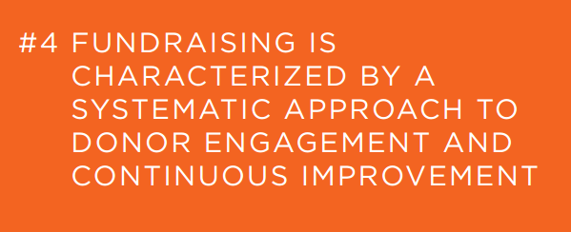
Notes:
Kim Leads…
What could you track now that would really help you?
Failure and success point you in the same direction.
Run Experiments, no blame…
Students with Framworksers, NCLR weekly data reviews - whats working whats not..

Slide 21

What is Core to your group’s approach & values?

Slide 22

Reflect:
How is fundraising from individuals a part of your groups core identity?

Slide 23
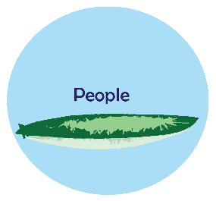
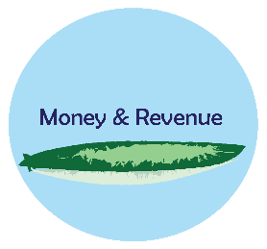
What’s Your Revenue Model?
Primary Stream & Sources
Secondary Stream & Sources
Commitment of People & Relationships to Pursue, Renew, Grow.

Slide 24
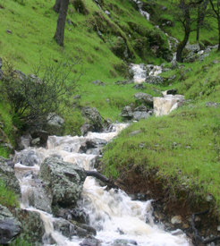

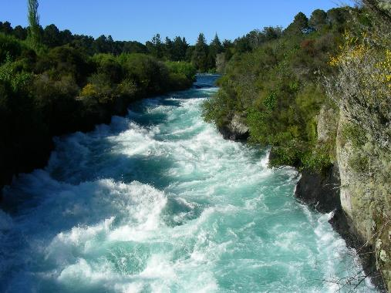

Slide 25
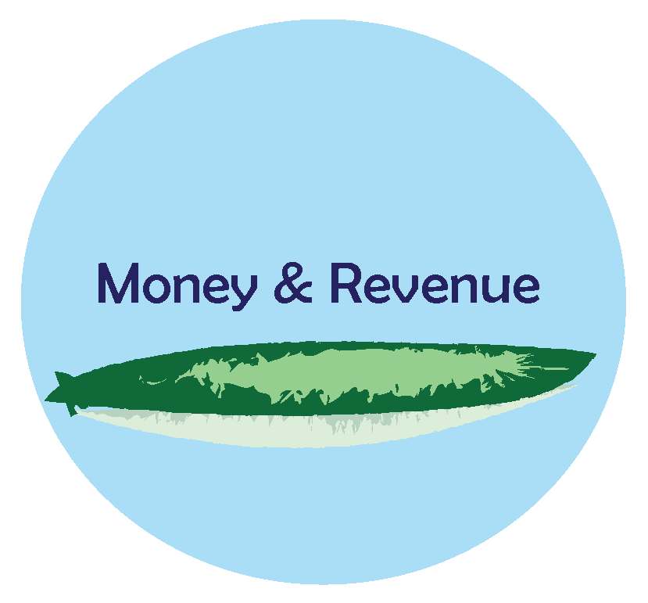
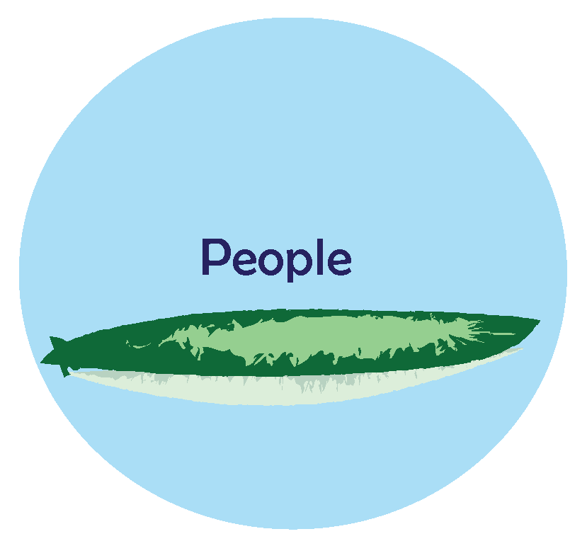
Reflect on right revenue
& right relationship

Slide 26
What’s Next for You?
Clarify your revenue model
Refine your Core Identity & Fundraising Statement
Connect with your coach before May 25th session.

Slide 27

Check in: Learning Pairs
What did each of you learn?
How will you engage others in the homework?
What time do you need to free up in order to apply the learning to your organization?

Slide 28

Evaluation

