Slide 1
Managing Risk in Turbulent Times
How Nonprofits Can Respond to the Watershed Moment
Ted Bilich
September 7, 2017

Slide 2

The Gathering Storm

Slide 3
Learning Objectives
Risk management is essential for nonprofits
Three basic tools of risk management
Resources for beginning the journey

Slide 4
Why is risk management important?

Slide 5
Who wants to be a headline?
Reports of Charter School Fraud
Grow as Oversight Continues to Lag
Nonprofit Accountability and Ethics:
Rotting from the Head Down
Nonprofit Organizations
More Susceptible to Fraud
for a Variety of Reasons
Chicana Service Action Center executives charged in $8.5-million fraud case
Daughter, mother who ran Suffolk nonprofit, Send
Thee Community Outreach, charged with fraud

Slide 6
Independent Sector:
“The board members of a charitable organization are responsible for understanding the major risks to which the organization is exposed, reviewing those risks on a periodic basis, and ensuring that systems have been established to manage them.”

Slide 7
Standards for Excellence Institute:
“Organizations should make every effort to manage risk and periodically assess the need for insurance coverage in light of the organization’s activities and its financial capacity.”

Slide 8
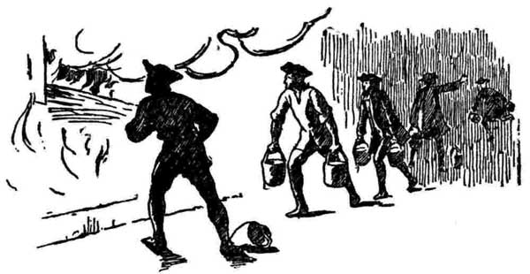
Why nonprofits really need risk management
Hand to mouth
Volunteers on the board
(Often) volunteers for “staff”
Needy service populations
Risky service populations
Understaffed, so blind spots
Lower paid, so hard to recruit and retain staff

Slide 9
Nonprofits say they want it
Ahead of the Curve (2016).
“Nonprofit leaders want support so that they can operationalize risk management. They don’t need to be convinced about its value. There was a uniform call for best practices, tools, networks, facilitation and consultants.” Ahead of the Curve (2016).

Slide 10
Funders are worried
“Nonprofits definitely need risk management, but they generally don't know about it. Smaller startups don't know what they don't know. Larger ones are sometimes so focused on mission that they don't realize that they are also business.”
“Many nonprofits probably know a little bit about risk management. As for adopting it, that tends to only be after a crisis. Board members tend to care about risk management only to the extent of director and officer insurance.”
“[I]t depends on the size of the organization, but budget priorities and bandwidth make it unlikely for an organization to focus on risk management until there is some incentive from the outside.”

Slide 11

“It takes 20 years to build a reputation and five minutes to ruin it. If you think about that, you’ll do things differently.” Warren Buffett

Slide 12
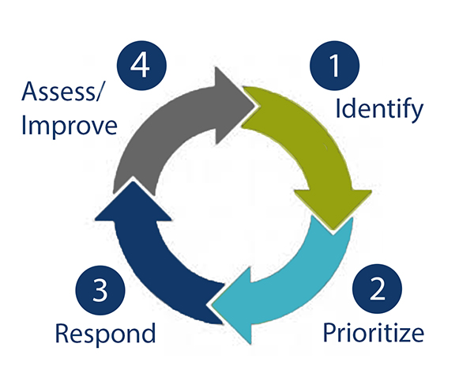
Common Vocabulary
Risk, Threats, Opportunities
Risk Management Process
Risk Inventory
Risk Register
Risk Cycle
Notes:
Vocab Handout

Slide 13
Tools and How to Begin

Slide 14

1. Risk Inventory

Slide 15
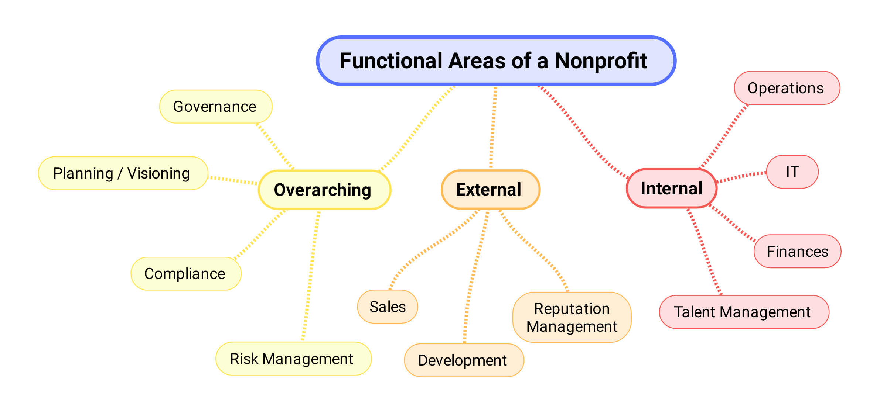
Where to look for threats and opportunities

Slide 16
Benefits of a risk inventory?
Different perspectives on risks
Different viewpoints about priorities
Forum for raising challenging issues
Clarity and consensus
Sense of ownership

Slide 17
Some Top Nonprofit Risks
Failure to document core processes
Funding diversification
Cybersecurity
Organizational culture

Slide 18
Risk Prioritization
A list without priorities is just a bunch of words.

Slide 19
2. Risk Register
Gathers and prioritizes threats and opportunities
Assigns risks to team member responsible for response
Summarizes active and proposed responses
Result - Living, changing, prioritized document in simple Excel format

Slide 20
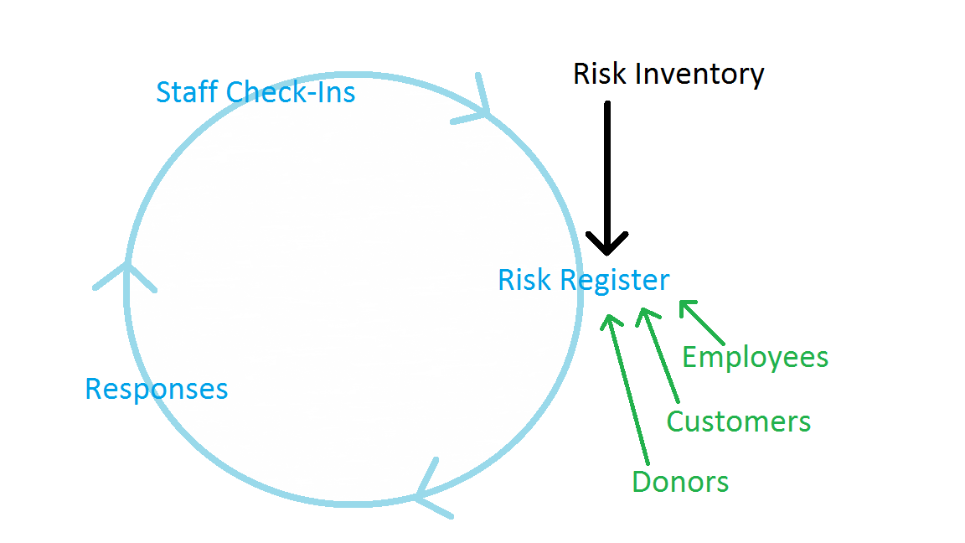
3. Risk Management Cycle
1
4
2
3
E.g., research, avoid, mitigate, shift, develop

Slide 21
How Funders Can Help
  Fund a risk inventory
  Fund basic training in an entire risk cycle
  Fund targeted coaching to build staff expertise

Slide 22
Why Funders Should Care
  Increased effectiveness
  Identify capacity issues
  Decreased downside risk
  Funding organizations with best practices

Slide 23
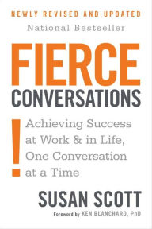
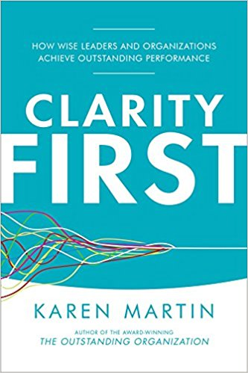
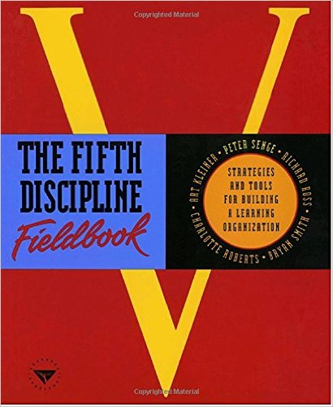
Resources

Slide 24
Contact Information
Phone – 703.652.5659
Email – tedbilich@risk-alternatives.com
Website – risk-alternatives.com

Slide 25
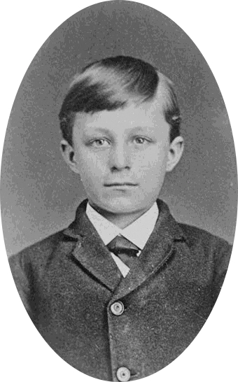

Slide 26
