Slide 1
WELCOME!
The webinar will begin shortly. Please join via web and phone.

Slide 2
The Annual Budget: Revisiting (And Challenging) Some Age-old Assumptions
FPN Webinar Discussion - March 7, 2017

Slide 3
A. What Informs Our Budgeting Approach Now?

Slide 4
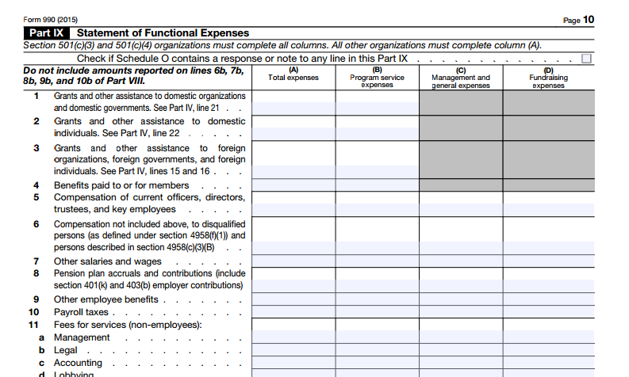
IRS Form 990 Requires Functional Expense Breakdown from 501c3s and c4s

Slide 5
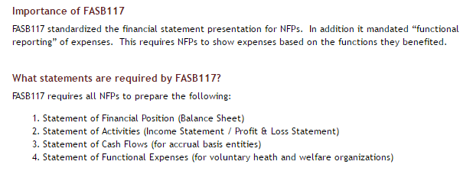
Generally Accepted Accounting Principles (GAAP) require functional expense classification, too.
http://www.nonprofitaccountingbasics.org/auditing/fas-117

Slide 6
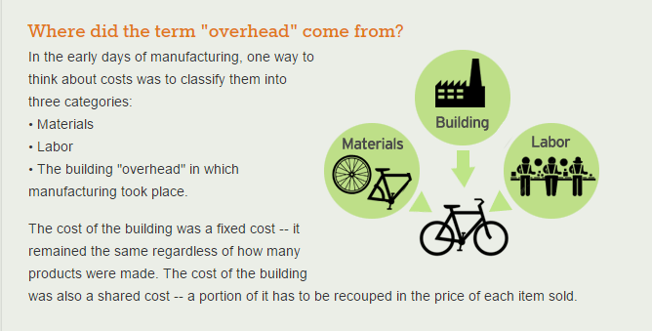
“Overhead” derives from a manufacturing assumption of business.
http://www.calnonprofits.org/programs/overhead/about-the-nonprofit-overhead-project/what-is

Slide 7
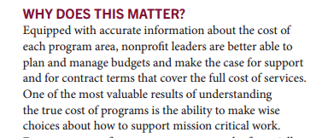
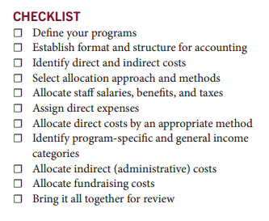
Our Collective Emphasis on “True Program Costs”
https://nonprofitsassistancefund.org/sites/naf-prod/files/publications/true_program_costs_-_program_budgets_and_allocations_2014.pdf

Slide 8
B. What’s Not Working?

Slide 9
What’s Not Working?
Where are the new costs of doing business?
PROGRAM EVALUATION
INNOVATION
CONTINUOUS LEADERSHIP DEVELOPMENT/PROFESSIONAL DEVELOPMENT
COMMUNICATIONS
DATA/KNOWLEDGE MANAGEMENT
NETWORK DEVELOPMENT
BUILDING/REPLENISHING THE VARIOUS KINDS OF CAPITAL NEEDED

Slide 10
What’s Not Working?
What are the unintended consequences of the old model?
Funding-driven and siloed structure and practice
False compartmentalization of efforts in an era of increasing integration/systems-thinking
False separation of action, reflection, and learning
Maintenance of systems and reporting that do not reflect how people actually want/are working and contributing to impact
Under-capitalization
Cartoon credit: http://www.chumans.com/blog/wp-content/uploads/2012/03/Systems-Thinking.jpg

Slide 11
C. Budgeting for Impact and the New Costs of Doing Business?

Slide 12
Traditional Model
 | Program A | Program B | Fundraising | Admin
Income
Expenses
Allocation
Net Result

Slide 13
funder compliance
monitoring progress on unsecured funds
testing new cost structure
managing multiple scenarios
other?
What’s the Primary Purpose of Your Budget?

Slide 14
program/shared/admin/fundraising
fixed/variable/pass-through
project-specific
change capital
other?
Structure to the Primary Purpose of the Budget

Slide 15
i.e. enrollment expectations
release schedule for restricted funds
foundation prospect likelihoods
donor campaign assumptions
other?
Develop Support Schedules that Substantiate Greatest $ Risk

Slide 16
Alternate and/or Additional Model
 | CORE/ FIXED | NEW COSTS/ CHANGE CAPITAL | VARIABLE/ PASS-THROUGH | TOTAL
Revenue
grants
fees
Expense
salaries
supplies
Surplus/Capital
working reserve facility/equipment

Slide 17
What Are We Adding/Correcting For?
Understanding the core and the variable costs of your organization
Making visible the new costs of business that drive your impact
Naming the kinds of capital that drive your impact

Slide 18
Questions to Guide Budgeting Change
Have we succinctly named our intended impacts as an organization?
Have we named how the organization needs to change to drive impact and what that will cost initially in time and money?
Have we assessed the level of integration of people and programs that will drive our impact?
How do our core revenue streams affect our choices in budgeting? How much freedom do we really have?
Are we committed to naming and funding our capital needs?

Slide 19
Closing Reflection

