Slide 1
Remote Work: A Case Study
Finance Professionals Network
September 14, 2016

Slide 2
Context & background
Rising cost of office space
Spacious, beautiful, light-filled office in prime location
Under-utilized space due to staff travel and meetings
Desire to reduce costs not directly related to program
Concerned about timing of lease expiration
Anticipated that significant change would be necessary

Slide 3
Steps to Successful Change
A model from John Kotter
Create the climate for change
Engage the organization
Implement & sustain the change

Slide 4
Create the climate for change
Step 1: Establish a sense of urgency
Seven year lease ending September-2015
Landlord offered ‘below market’ renewal ($59 per sqft for 14k sf = $825k/year)
Investigated Oakland options (estimated at $43 per sqft for 14k sf = $602k/year)
Preference for downtown San Francisco location (estimated $65 per sqft for suitable space)
Began to consider how/if we could use rent a smaller space

Slide 5
Create the climate for change
Step 2: Build the guiding team
Leadership Team: assessed strategic and values choices associated with cost of space
Finance Admin Sub team (FAST): managed the project and logistics
Staff Council: represented staff perspective and supported all aspects of transition – external research, policy formation, design trade-offs, furniture and technology selections, etc.

Slide 6
Create the climate for change
Step 3: Get the right vision
Space Brainstorm: determine priorities
Branding: incorporate new colors and images into space design
Strategic Planning: clarify organizational priorities and business model

Slide 7
SPACE BRAINSTORM
Align to Values | Allocate resources fairly & uniformly Each team has green/sustainability goals
Remote Access | Flexibility of remote work & access Away time boundaries Remote is a choice, not for everyone Allow for different schedules, flex office hours
Practices | Less email, more IM Set times for meetings More consciousness of NY/SF work hours Paperless, evaluate what can be discarded/moved/stored Update purchasing practices (sustainable) (Re)Educate staff about policies & procedures Dedicated days/times for all staff (and/or team) to gather

Slide 8
SPACE BRAINSTORM
Physical Space | Share space with others Relaxed meeting space Maintain parenting rooms Quiet (library) space Sitting/standing desks Maintain/improve bike friendliness Offsite (or NO?) storage Smaller footprint Near public transit
Technology | New computers (laptops with screens) for all Uniform process/platform, greater efficiency Dev & Prog on same platform (SalesForce) Additional (re)training on key systems Collaboration tools for remote access New online space for relationships with grantees, advisors, and donors

Slide 9
BRANDING

Slide 10
STRATEGIC PLAN GOAL #5
Embed nimbleness, innovation and collaboration throughout our systems, culture, talent, activities and values.

Slide 11
Steps to Successful Change
A model from John Kotter
Create the climate for change
Engage the organization
Implement & sustain the change

Slide 12
Engage the organization
Step 4: Communicate for buy-in
Remote Work Policy
Up to two days remote
Flexibility and autonomy over schedule
Applies to everyone
Optional
Attend team meetings in person

Slide 13
Engage the organization
Step 5: Empower action
Technology Standards
Laptop, headset, keyboard, mouse, power, and software
Support on-site and remote
Training on hardware set-up plus Box, Outlook, Lync, and Salesforce
Consistent onsite set-up
Offered ‘extra’ equipment

Slide 14
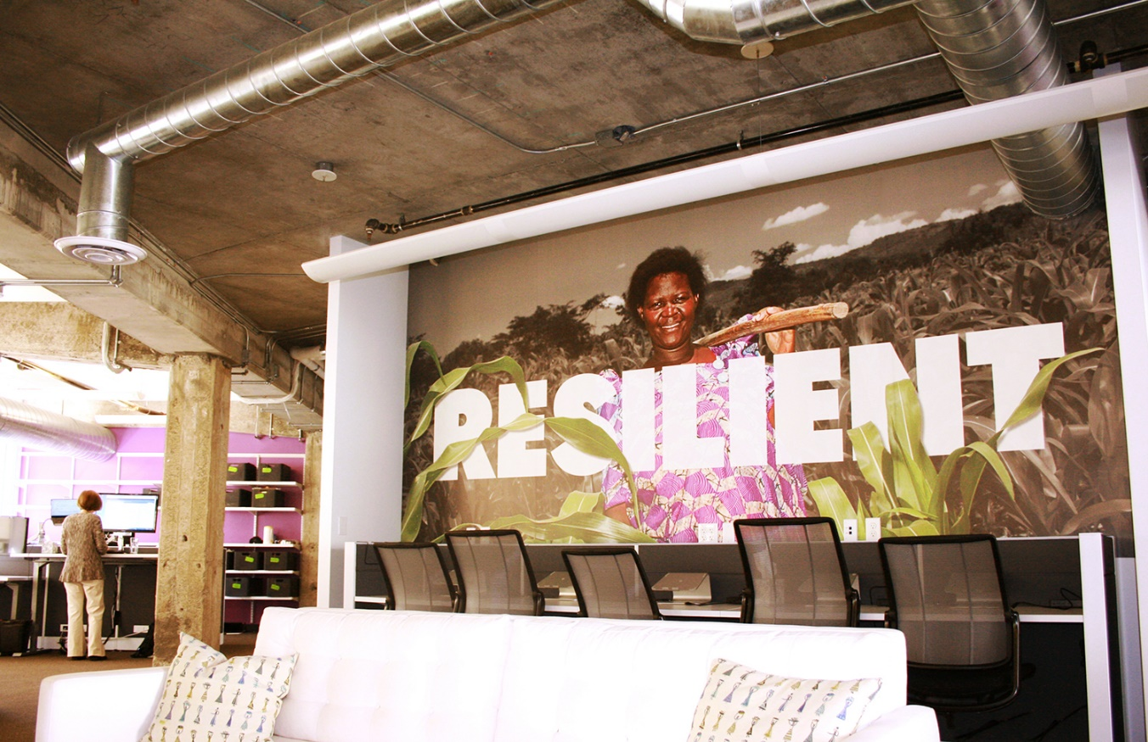
Engage the organization
Step 6: Ensure short-term wins
New laptops and cubbies
Cloud-based systems (paperless)
Consistent set-up of sit-stand workstations (on-line sign up)
No assigned workstations

Slide 15
Steps to Successful Change
A model from John Kotter
Create the climate for change
Engage the organization
Implement & sustain the change

Slide 16
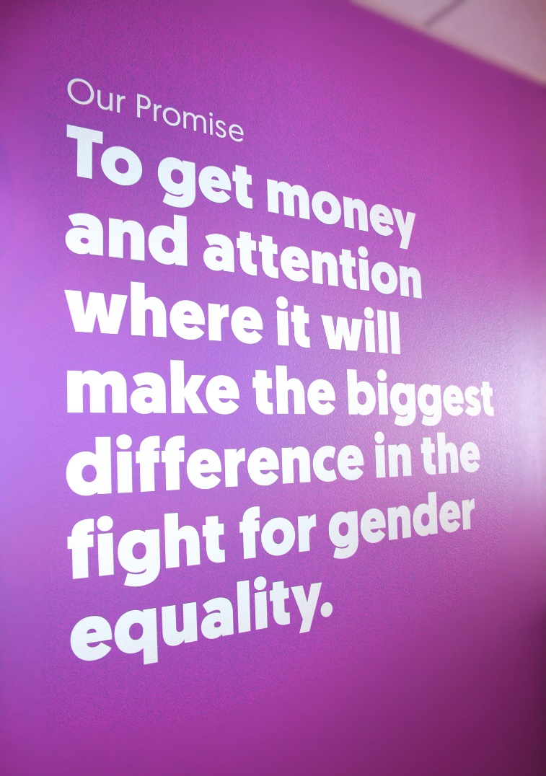
Implement and sustain the change
Step 7: Don’t let up
Allow fully remote
Re-hire former staff
Relocate New York team to WeWork

Slide 17
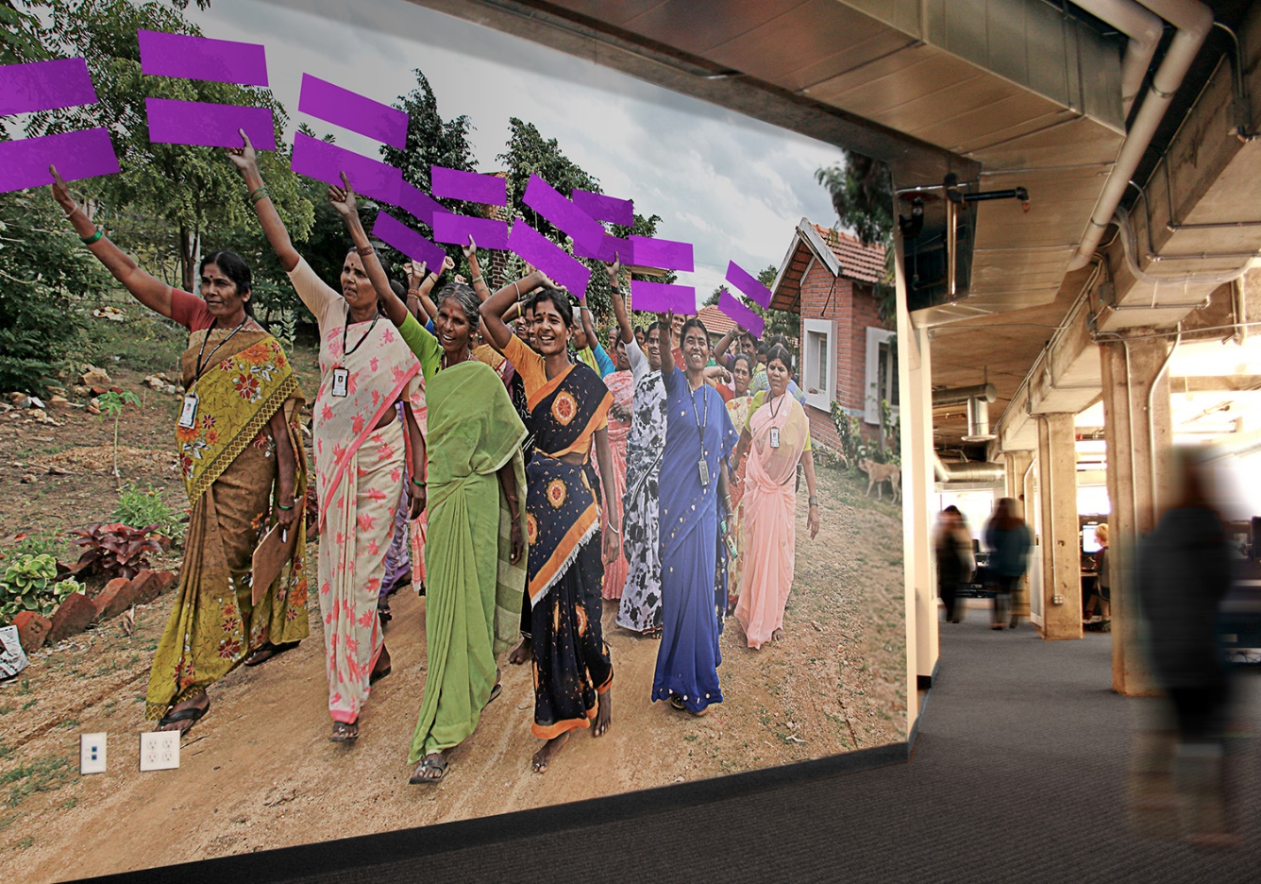
Implement and sustain the change
Step 8: Make it stick
Ongoing training (led by Staff Council)
Incorporate technology standards into performance management process
Recently revised, loosened the desk sign-up policy

Slide 18
Conclusion
Happily ever after...
Beautiful, light-filled office in prime location
Sufficient space for all staff needs (24 workstations and 10 ‘touchdowns’)
Reduced space costs by 50%
Reduced square footage by 66%
Transition was significantly less difficult than expected
Positive effect on culture and productivity

