Slide 1
This is the Moment for Visionary Narratives . . .
“It feels like new media platforms launch every day, but are only being used to tell the same old stories, enforcing the current limits of our collective imagination. And it is clearer than ever that we are currently trapped inside the imagination of people who are not committed to a future that includes us . . . And now we are in it, and it is in us . . . we need to be the storytellers of the next phase of the future. And we need to concern ourselves not just with the content of our liberating imaginings, but with how we will imagine together.”
-Detroit Narrative Agency

Slide 2
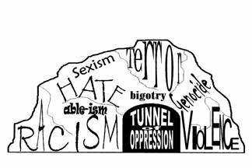

Kickoff Retreat Goals
Reflect on Leadership Journeys
Deepen awareness of impacts of oppression
Build the HIVE Community

Slide 3
Kickoff Retreat Agenda
Day 1: Jan 23 | Day 2: Jan 24 | Day 3: Jan 25
Welcome, Overview, Community Guidelines | Overview & Check-in | Overview
Celebratory Lunch | Repro Leader Case Study | Check-in
The HIVE Program | Leadership Journeys | HIVE Strategy Studio
Community Builder | Physical Activity | Purpose & Values Reflection
Stories of Inspiration | Cycle of Oppression | What’s next?
What makes a leader? | Developmental Strategy for Liberation | Closing Circle
Walk & Talk | Closing Reflections
Closing Reflections | Informal Commuity Time

Slide 4
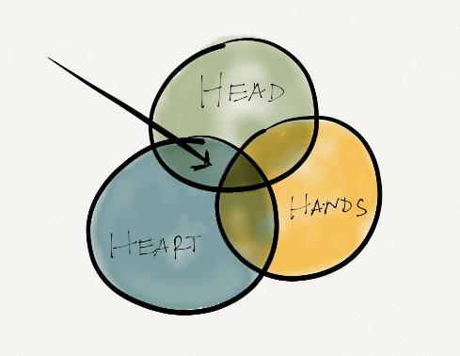
Community Guidelines
Show up
Trust the process
Step up/step back
Bring heart, not just mind
Relaxed rigor
Confidentiality
5x bolder
Accept and expect non-closure

Slide 5
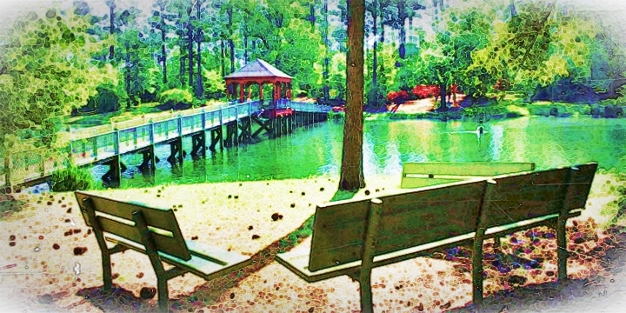
Solomon Episcopal Conference Center

Slide 6

For over 40 years, CompassPoint Nonprofit Services has worked in the SF Bay Area and Nationwide, strengthening today’s leaders and helping to grow a healthy pipeline of diverse leaders for the future.
Teaching
Coaching
Consulting
Cohorts
INTEGRATED PRACTICE:
Grounded in deep nonprofit leadership experience and an approach that is responsive to the needs of diverse leaders and communities
SERVICES INCLUDE:
Building skills & developing leadership
Consulting & coaching to amplify org impact
Cohort focused initiatives
Research & publications

Slide 7
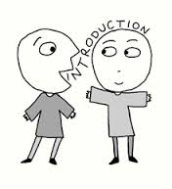
Introductions
Name
Organization
One hope

Slide 8
The Big Picture: Why HIVE?
The State of the Reproductive Health, Rights, & Justice leaders Movement
The State of the Nonprofit Sector
Chronic underinvestment in leadership development (less than 1% of philanthropic funding) + 25% growth of nonprofits in the last decade
Lack of leadership teams able to fulfill emerging missions and adapt to fast-changing demands
Lack of opportunities to grow from within and mentoring and training opportunities
An abundance of talented, committed people. To succeed, they need to:
  Have time to be able to experiment
  Build strong teams
  Participate in cross-sector networks
  Collaborate to achieve outcomes
  Opportunities for training, mentoring, coaching
Leaders working to ensure that people have control over their sexual and reproductive lives facing tremendous challenges, and even more so now . . .
Unprecedented wave of state-level restrictions on reproductive choice, education and access to adequate health care. Enactment of at least 60 bills in 2016. LA had highest number of anti-abortion bills of any state in 2016.
Profound racial and economic disparities, leading to a deeply fractured movement.
Many remarkable RHRJ leaders working to mobilize communities; advocate for access to healthcare and education; and enact legislation.
To succeed, they need an inclusive, interconnected reproductive health, rights, and justice movement that represents the voices of all communities.
Adapted from “What social-sector leaders need to succeed” by Laura Callanan, Nora Gardner, Lenny Mendonca, and Doug Scot; Center for Reproductive Rights ; Rockwood Leadership Institute

Slide 9


50 leaders met in Sep 2015 . . .
Trust & Connection
  “meeting gave me an opportunity to see firsthand how much is happening across the state but also highlighted our disconnectedness”
Program Sustainability
  “We get going on a great task and then funding goes and we start the wheel turning all over again.”
Training to confront racism, sexism, & other -isms
  “training and support in advancing a set of workable goals but using a liberating and intersectional lens.”
  “internalized oppression [can lead to a] lack of confidence [in leadership]”
Physical & mental well-being
  “SELF-CARE! The irony is the work for health + equity kills women of color.”
  “I need help confirming that the awesome things I have done are real even . . . in a climate where . . . the issues I advocate for are difficult, not valued, and under resourced.”
(+Coaching & Technical Skills)

Slide 10

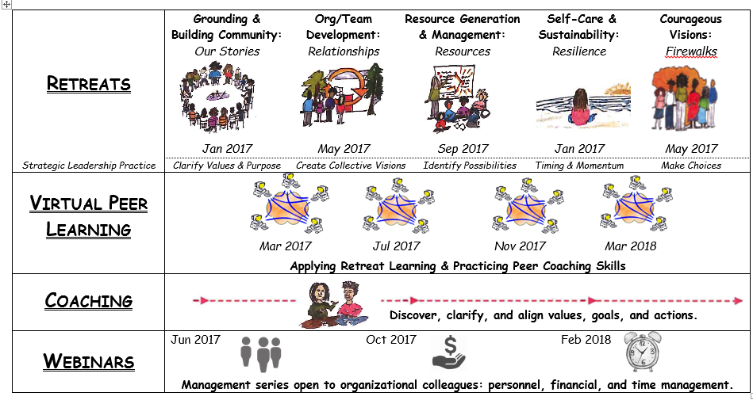
Program Road Map
Program Outcomes:
The 3 R’s
RELATIONSHIPS:
To build trust
To break down silos
To deepen collaboration skills and practices
RESOURCES:
To develop tools and new ways of thinking about generating, navigating and managing resources for sustainability
To reflect on and discover personal, organizational and field level strengths
RESILIENCE:
To fill up again and develop practices for self-care and rejuvenation
To name, address and heal from the impact of racism, sexism, classism, and other forms of oppression

Slide 11

Chalk Talk
What do you see?
What does it mean?
What does what we wrote tell us suggest about our group?
What do the responses say about your leadership?

Slide 12
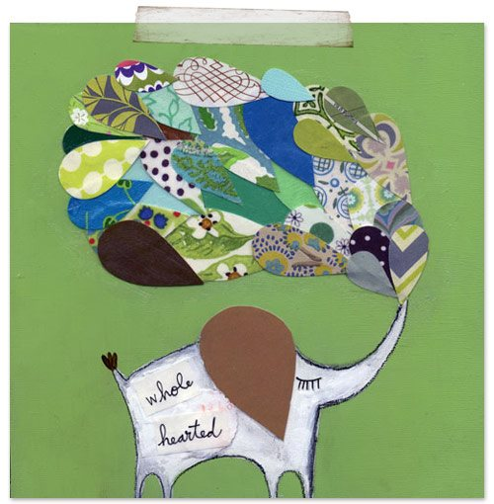
Personal Leadership Journey
“Owning our story can be hard but not nearly as difficult as spending our lives running from it. Embracing our vulnerabilities is risky but not nearly as dangerous as giving up on love and belonging and joy -- the experiences that make us the most vulnerable. Only when we are brave enough to explore the darkness will we discover the infinite power of our light.”
- Brené Brown
Notes:
What resonates? Let me share why I think it’s so difficult, really, to own our stories.

Slide 13
Personal Leadership Journey
Create a personal leadership journey map (25 min).
Share your journey in small groups (10 min each = 30 min).
Create a storyline (10 min)
Share your story lines (1 min each = 16 min).

Slide 14
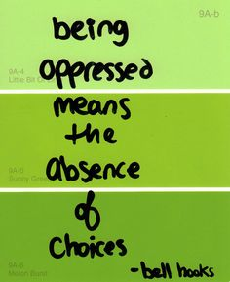
Understanding Oppression
Oppression Is...
“A System of Advantage, Entitlements, and Benefits Based on
Group Membership
That allows for the Systematic Mistreatment of Others”
“Prejudice + Power” by David Wellman

Slide 15
Understanding Privilege
TYPES OF OPPRESSION | VARIABLE | PRIVILEGE GROUPS | TARGET GROUPS
Racism | Race/Color | White | People of Color (African, Asian, Native, Latino/a Americans
Sexism | Gender | Men | Women
Classism | Social-Economic Class | Middle, Upper Class | Poor, Working Class
Elitism | Educations Level Place in Hierarchy | Formally Educated Managers, Exempt, Faculty | Informally Educated Clerical, Non-Exempt, Students
Religious Oppression Anti Semitism | Religion | Christian, Protestants Christians | Muslims, Catholics, and Other Jews
Ageism Adultism | Age | Young Adults Adults | Elders (40+ by law) Children
Heterosexism | Sexual Orientation | Heterosexual | Gay, Lesbian, Bisexual, Transgender
Ableism | Physical or Mental Ability | Temporarily Able-Bodied | Physically or Mentally Challenged
Xenophobia | Immigrant Status | U.S. Born | Immigrant
Linguistic Oppression | Language | English | English as a Second Language Non-English
Unearned benefits given to people who fit into a specific social group
Privilege
(adapted from Visions inc.)

Slide 16
Levels of Oppression
Personal
Interpersonal
Cultural
Institutional
Adapted from Doing Psychology Critically by Isaac Prilleltensky & Geoff Nelson

Slide 17
Cycle of Oppression
Born
Conscious and Unconscious Acceptance
Socialized
Cultivating
Shame
Comparison
Disengagement
Status Justified Treatment
Roberta Harro

Slide 18
Guide for Constructive Listening
Each person is given equal time to talk.
The listener(s) does not interpret, paraphrase, analyze, give advice, or break in with a personal story.
Confidentiality is maintained.
The talker is not to criticize or complain about the listener or about mutual colleagues in her/his turn.

Slide 19
Personal Experience Panel
How do my early life experiences with oppression influence me as a leader today?
Panel Question (4 min per panelist)
Pair Share: How were you impacted by what you heard? (2 min per person)
Groups of 4 (4 min per person)

Slide 20
Power
Status
Rank
(privilege)
power
Interactional style
Unearned benefits given to people who fit into a specific social group
Inner Power, Power to, Power with, Empowerment
(adapted from Beyond Inclusion, Beyond Empowerment by Leticia Nieto and Margot F. Boyer)

Slide 21
The Journey to Liberation
Structural Power: access, opportunity, authority
power
Social Power: Relational, Inter- and Intra-group
Personal Power: Agency/Ability

Slide 22





Developmental Strategy for Liberation
(adapted from Leticia Nieto)
New ways of being: habits, hearts, and minds
Re-centering
living by our own optimal, liberating norms & values
Strategy
choosing battles & most effective action
Empowerment
waking up from a deep sleep through a thrust of energy
Confusion
a glitch in the matrix?
Survival
conforming to expectations & stereotypes
Redefining who we are
Building alliances
Acting vs. reacting; calibrating our investment, energy, and thought.
Regular access to empowered, target-only spaces
Holarchical (these are skills, not stages)
Moment-to-moment we don’t always use widest skill set we have access to
A life-long task to strengthen our skills
(adapted from Beyond Inclusion, Beyond Empowerment by Leticia Nieto and Margot F. Boyer)

