Slide 1
Unconscious Bias in HR Systems
Zoë Polk, Policy Analyst from the SF Human Rights Commission
Michelle Natividad Rodriguez, Senior Staff Attorney from the
National Employment Law Project
HR Network webinar hosted by CompassPoint
December 14, 2016

Slide 2
Boxed In: Limitations and Strategies for Addressing Discrimination in Hiring
Presented by Zoë Melissa Polk of the San Francisco Human Rights Commission

Slide 3
About the San Francisco Human Rights Commission
Oldest municipal Human Rights organization
Created in 1964 in response to racial bias in hotel and auto industry hiring practices
Modeled city ordinance after 1964 Civil Rights Act and has since then passed ordinances prohibiting discrimination based on gender identity, HIV/AIDS status, Height and Weight
2014 Fair Chance Ordinance was passed, regulates the use of the background checks in employment and housing. It is the only law in the country that regulates housing and employment

Slide 4
Learning Goals
History of Civil Rights Laws
Limitations of current civil rights legislation
Laws limitations
Institutional Racism as a challenge
Structural Racism as a challenge
Addressing Today’s Challenges

Slide 5
Government Accountability
Systematic Inequities are not accidental. Throughout history, the government created and perpetuated inequities.
Notes:
Must acknowledge that the government operates from a place of trying to undo bad policy it created
With this acknowledgment comes the responsibility of private actors: community groups and businesses must end inequities on parallel track along side government.

Slide 6
Government Solution: Throw Good Policy After Bad
Anti Discrimination Laws
Current Ban the Box Laws
Laws were written in a time when discrimination was practiced openly
Similarly, Ban the Box laws written to address direct, public discrimination

Slide 7
Do job announcements for your company contain any language about criminal background checks?
Polling Question

Slide 8
Policy Gaps: Discrimination Goes Behind Closed Doors
The 1964 Civil rights movement was successful for transforming racism from a source of pride to shame.
Poll Question: Are we seeing the same turning point for discrimination against persons with arrest and conviction records? (Answer Yes or No)
Notes:
Question

Slide 9
Today’s Challenges: -Limitation of Laws -Structural Racism -Institutional Racism

Slide 10
Under Limited Law, How Do You Prove Discrimination?
Disparate treatment Overt differential treatment, including statements, actions. It still occurs but not as common since1964.
Example: A supervisor advising a female employee that she should smile more to be promoted.
Harassment
Unwelcome conduct based on protected category.
Example: An office culture that permits culturally offensive jokes
Disparate impact a neutral policy or practice that has discriminatory effect.
This theory is how EEOC got to prohibiting discrimination against persons with arrest and conviction records
Example: A policy requiring Spanish language for entry level staff but not executive management.
Notes:
Disparate treatment still occurs but not as common as 1964 (interpersonal)
Its up to the person on receiving end to prove discrimination took place

Slide 11
Institutional Racism
Policies and practices within and across institutions that intentionally or not, produce outcomes that chronically favor or put a racial group at a disadvantage.
Example: In response to ban the box law/restrictions on reviewing criminal background checks, employers refuse to interview persons with African American or Latino sounding names
Example: A hiring committee that declines to make an offer to a finalist because of “unexplained gaps” in their resume.
Example: A company that uses a background check company that provides employers with a red light or green light about an applicant, but does not provide specific information on the background check report.

Slide 12
Structural Racism
A condition in which bias manifests across institutions and society.
Example: State laws regulating marijuana dispensary ownership that prohibit persons with conviction records from going into legalized marijuana business
Example: Multiple law enforcement agencies have a practice of not hiring persons with criminal background, despite data evincing over criminalization/racial profiling of Black and Brown communities

Slide 13
Key Take Aways and Next Steps
Develop solutions based on experiences and priorities of impacted people
Prioritize leadership development pathways
Interrupt interpersonal/ implicit bias in the context of addressing structural and institutional racism

Slide 14
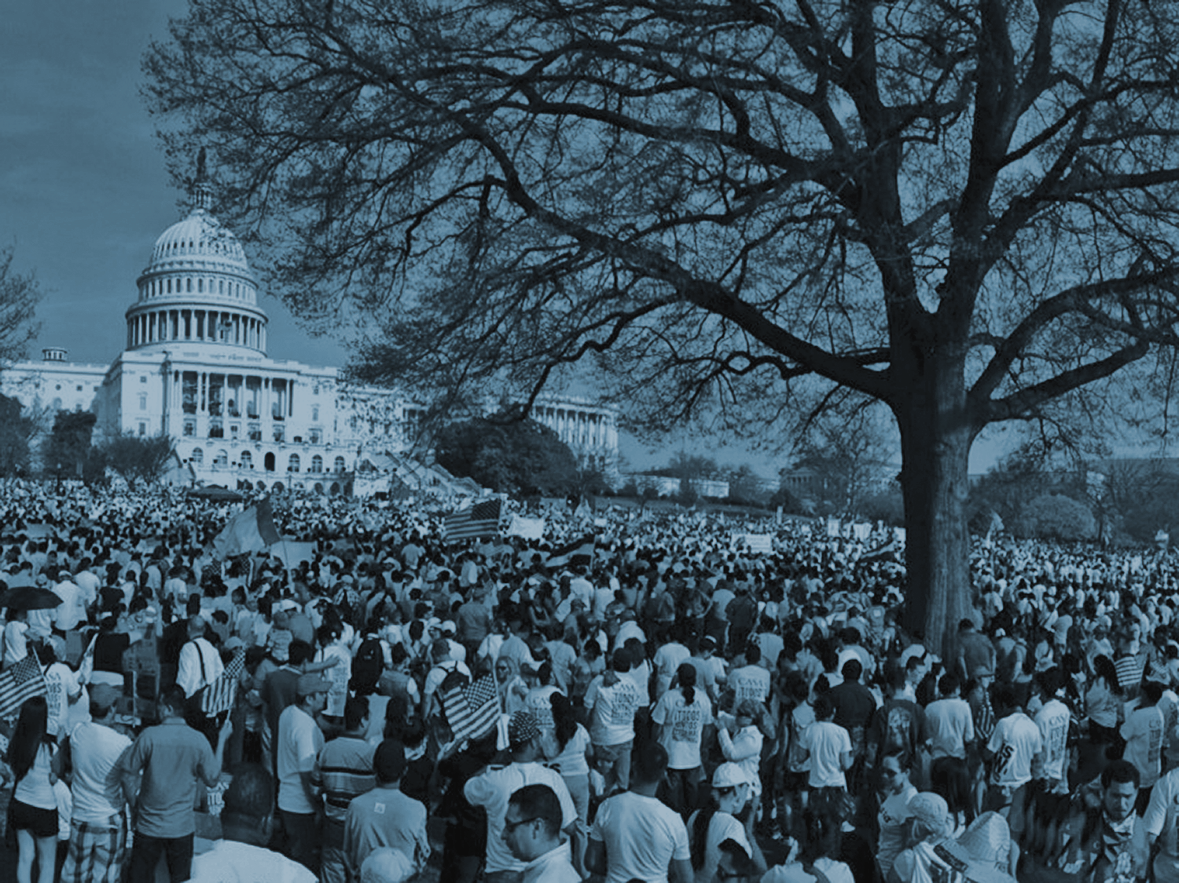
Advancing Vision of Equity Policies and Practices in the Workplace
December 14, 2016
Michelle Natividad Rodriguez
Senior Staff Attorney
mrodriguez@nelp.org
@michnrodriguez

Slide 15
National Employment Law Project
“The campaign leading up to [the] election also reflected how division and despair can be channeled into hatred and intolerance, targeting immigrants, women, people with disabilities and others as the reason so many have fallen behind—and in so doing, can give voice and vindication to our worst instincts as a people and a nation. This is profoundly wrong, and something we should not and cannot tolerate."

Slide 16
Goal and Steps
To develop policies and practices that promote equity: You are the HR experts and can be change agents for implementing policies and practices.
Step one: Introduce ideas based on research on fair-chance employment.
Next step: Get your feedback and refine policies and practices.
NB: Only one element of creating lasting change.

Slide 17
Poll Question:
Do you think there’s racial and gender equity in your organization?

Slide 18
Could you answer the poll question?
It’s not about intent. Do we understand the racial and gender outcomes? What are the demographics? Turnover? Hiring? Promotion?
Distribution of power in job positions: Who is in leadership? Who is on the board? Who makes decisions and has authority? Controls resources?
Comparing salaries and benefits: What do Black staff earn? Latinx? Asian? By gender? How do they compare? E.g., college educated Black women and Latinas earn 70% of similarly educated white men.¹
1. Pew Research Center, “Racial, gender wage gaps persist in U.S. despite some progress” (July 1, 2016).

Slide 19
Implicit Bias Research

Slide 20
Implicit Bias Research
Male and white performance is overestimated and associated with competence and ability: 79% of resumes with man’s names were worthy of hire vs. 49% of women’s names.¹ White-sounding names equals 8 yrs of experience. ² Women’s odds in orchestras increased by 50% in blind auditions.³
People of color are held to more rigorous standards: Law partners graded Black attorneys lower. White attorneys had “potential.”⁴
Impacts: People of color and women are not given same opportunities, are held to higher standards, and have to prove more.
1. Steinpreis, Anders, & Ritzke (1999). 2. Goldin & Rouse (2000) 3. Bertrand & Mullainathan (2004). 4. Reeves (2014). Information derived from Facebook, Managing Bias materials.

Slide 21
Structuring Policy and Practice to Minimize Biases in Hiring

Slide 22
Policy and Practice (Recruitment)
Establish objective criteria for recruitment: Without defining merit prior to evaluating, merit for the job fits the mold of applicant preferred. In study, men who committed to hiring criteria before evaluating police chief candidates didn’t show bias against women candidates.¹
Base criteria on experience, not just credentials: Emphasis of credentials over experience may have disparate impact.²
Use inclusive language: Language of job announcements influences applicant pool.³
Race and gender blind review of resumes if possible. See resume studies and orchestra example.⁴
1. Uhlmann & Cohen (2005). 2. Nelson & Tyrell (2015). 3. Gautcher & Friesen (2011); Taris & Bok (2010). 4. Steinpreis, Anders, & Ritzke (1999); Goldin & Rouse (2000); Bertrand & Mullainathan (2004).

Slide 23
Policy and Practice (Hiring)
Structured interviews: train interviewers, consistent questions
Training can reduce cognitive errors (e.g., exaggerating competence, similarity bias).¹ Highly structured interviews (e.g., pre-determined questions focused on job-related traits) reduced racial group differences compared to low-structured interviews.²
Consistent rating during interview with a diverse panel, not just rating overall impression:
Rating scales reduced ambiguity. Rating individual responses increased accuracy of judgment, especially with note taking of interviewers. Multiple, diverse reviewers decreases individual bias. Articulate rationale. ³
1. Bragger (2002). 2. Fay & Latham (1982); Purkist (2006). 3. Campion (1997).

Slide 24
Structuring Policy and Practice to Minimize Biases On the Job

Slide 25
Poll Question:
Does this occur in your organization?
People of color and/or women are interrupted when they are speaking more frequently.
People of color and/or women do not have ideas or success attributed to them as frequently.

Slide 26
Bias On the Job
Less credit given, perceived smaller contributions to success, blame for failures: When men and women work together, women given less credit, viewed as making smaller contribution and blamed more for failures.¹
Impact: Success in men attributed to their skills, while success in women attributed to help from others, getting lucky and working hard. Therefore, women are less likely to influence.
Policy and practice: Set ground rules for noting contributions and attributing success; and interrupt the interrupters.
1. Heilman & Hayes (2005); information derived from Facebook, Managing Bias materials.

Slide 27
Brainstorming Next Steps

Slide 28
Some first steps…
Monitor demographics and equity. Track organizational patterns. Who’s on staff? Who is hired or promoted? Who leads, has agency, decision-making authority?¹
Support staff in raising concerns collectively and promote open, productive communication. Promote a safe space and support opportunities to organize; e.g., unions, race caucuses, meeting spaces and time. Invest in building dialogue skills and providing feedback. ¹
Is there a shared understanding of where the organization is? Is there a vision of prioritizing racial and gender equity?
1. Berthoud and Greene “The Paradox of Diversity in Social Change Organizations”

Slide 29
What can we do…
Consider the suggestions included in this presentation: What resonates? What seems effective? What would address concerns you have?
Could you imagine adopting these policies and practices? What’s the process for that? Would an agreed upon best practices or policies work?
Be prepared to workshop…

Slide 30
Resources
National Employment Law Project: Michelle Natividad Rodriguez, Senior Staff Attorney, mrodriguez@nelp.org
Equal Justice Society:
https://equaljusticesociety.org/
Race Forward: www.raceforward.org
Perception Institute: https://perception.org/

Slide 31
National Employment Law Project
75 Maiden Lane, Suite 601
New York, NY 10038
212-285-3025 tel | 212-285-3044 fax
www.nelp.org
©2016 National Employment Law Project. This presentation is covered by the Creative Commons “Attribution-NonCommercial-NoDerivatives” license fee.

