Slide 1


Fundraising Bright Spots
Kick off webinar, January 30, 2018

Slide 2
Introduce yourself in chat response
Your Name
Your Organization
1 Strength you bring to developing donor relationships

Slide 3
Bright Spots Learning Community
Five full day sessions.
Learning & Action Pairs.
Our team will be available for check in and coaching in between sessions.
Share results, learning @ each session in the large group.

Slide 4
About the Learning Community

Slide 6
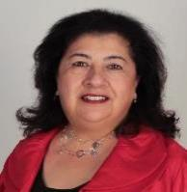
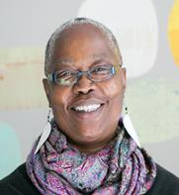
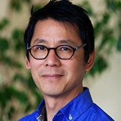
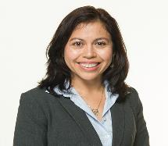
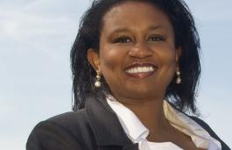
Meet the LA Bright Spots Team

Slide 7
Day 1: Wednesday, Feb. 14, 2018
Is fundraising core to our identity as an organization?
How does fundraising happen now?
How can it happen in a more distributed way?

Slide 8
Map Out Current Fundraising
What do you do?
Identify new supporters
Secure event sponsors
Thank donors
Social media

Slide 9
Bright Spots?
What am I doing well? What am I not doing?
Not really working
Why are they succeeding?

Slide 10
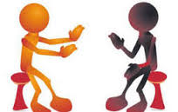
Form A Strong Learning Pair…
What do each of you want to learn?
What are each of your learning styles?
Are there any positional power differences? How can you also be learning peers?
What time do you need to free up in order to apply the learning to your organization?

Slide 11
Preparation
Take time to discuss how you want to participate as a pair.
Look for email regarding pre-reading, and any documents to bring (digital or hard copy).
Consider learning from a ‘bright spot’ in your organization.

Slide 12

Comments? Questions?

