Slide 1
ORGANIZATIONAL EQUITY LEADERSHIP DEVELOPMENT PROGRAM
SESSION THREE: April 27, 2018

Slide 2
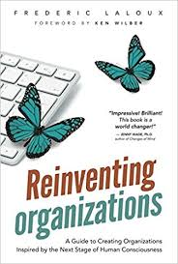
HOW CHANGE HAPPENS

Slide 3
PRINCIPLE ONE: Change is Constant
More cyclical than linear
People don’t
“manage” change
we shape it

Slide 4
PRINCIPLE ONE: Change is Constant
What cycles of change have we seen in our organization?
What patterns do we notice?
What conditions are present in various stages of the cycle?

Slide 5
PRINCIPLE TWO: Intentional Adaptation
Move with intention
What you pay attention to grows

Slide 6
PRINCIPLE TWO: Intentional Adaptation
How are we cultivating what’s needed in this moment?
What choices are we making about our attention?

Slide 7
PRINCIPLE THREE: Small is good, small is all
Fractals: what we practice at the smallest scale
set the patterns for the whole
Critical connections
over critical mass

Slide 8
PRINCIPLE THREE: Small is good, small is all
When does my personal way of being
– both what I do and how I do it –
reflect the world I want to live in?
Which teams most embody our vision and values?
What conditions have allowed those teams to thrive?

Slide 9
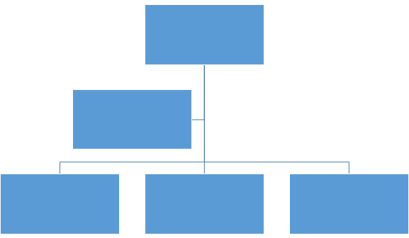
REINVENTING ORGS: Amber (conformist) Worldview
ORGANIZATION AS PYRAMID
Organizations operate from an assumption of stability and certainty. They are highly structured and rules-based, often assuming one right way of doing things, with clear rituals and processes that create predictability. Formal power and decision making is often concentrated “at the top.”
BREAKTHROUGHS
Replicable process
Stable org charts

Slide 10
REINVENTING ORGS: Orange (achievement) Worldview
ORGANIZATION AS MACHINE
Organizations operate from an assumption that interconnected parts can be manipulated and tinkered with for an improved “output.” They are focused on the question of “what if” - pursuing solutions followed by a relentless focus on “efficiency” with an aim to achieve more, faster.
BREAKTHROUGHS
(Myth of) Meritocracy
Innovation
Accountability

Slide 11
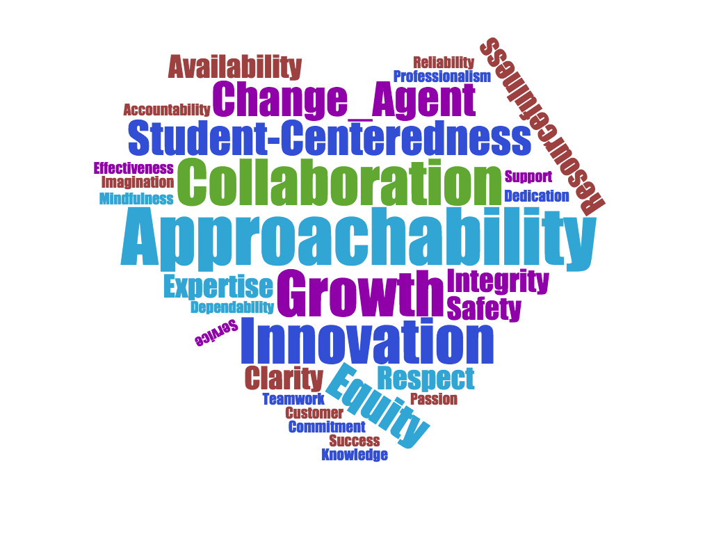
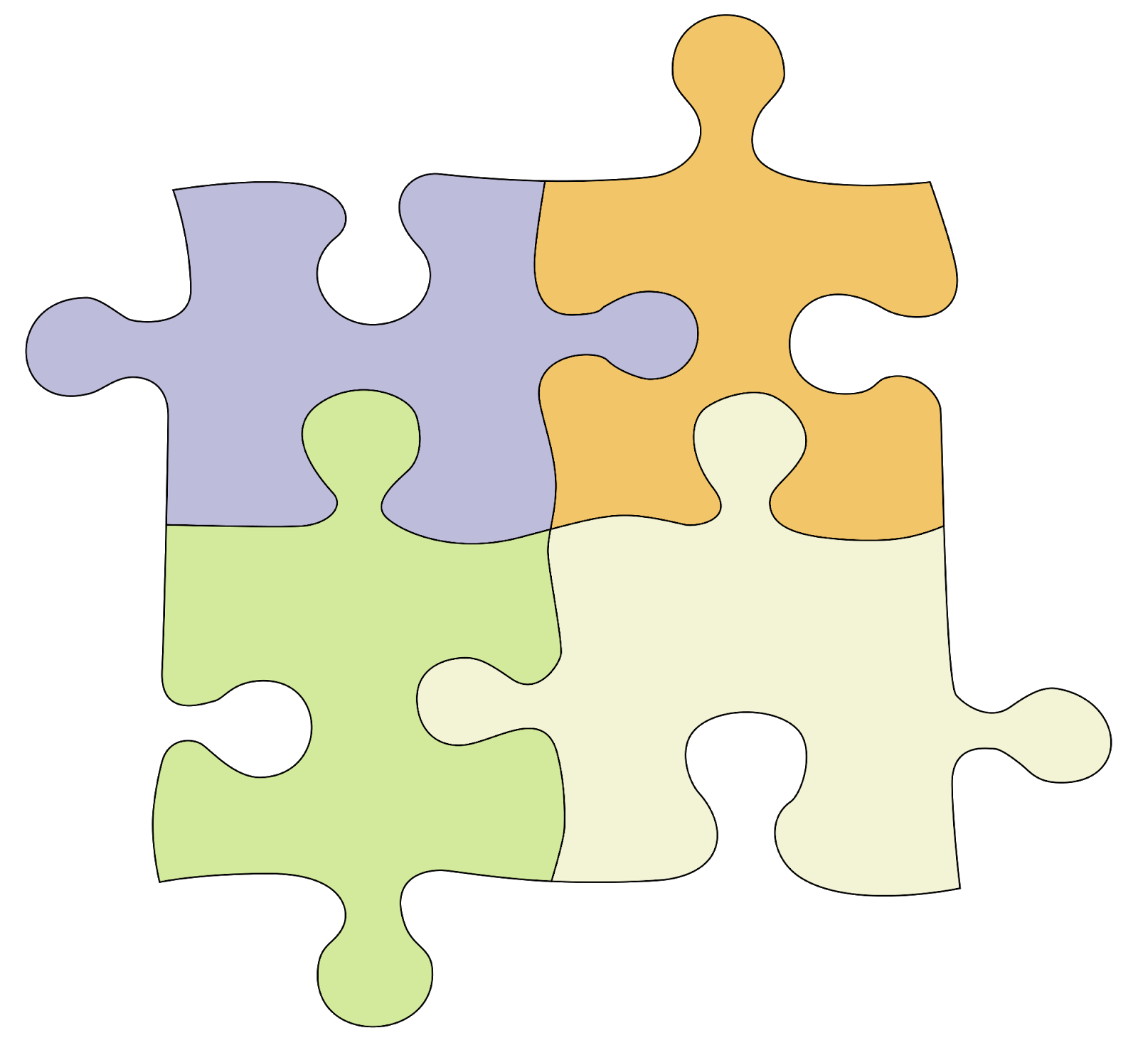
REINVENTING ORGS: Green (pluralistic) Worldview
ORGANIZATION AS FAMILY
Organizations operate based on a sense of community and collective meaning, centered around creating a sense of belonging and shared purpose. There is an assumption that people are inherently valuable and all voices deserve to be heard.
BREAKTHROUGHS
Values-driven culture
Stakeholder
value
Empowerment

Slide 12
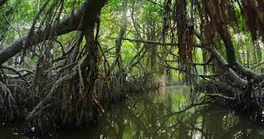
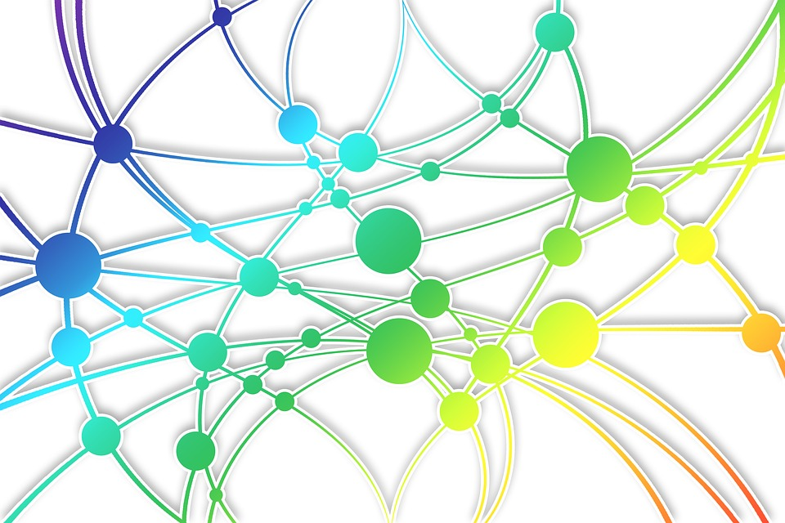
REINVENTING ORGS: Teal (evolutionary) Worldview
ORGANIZATIONS AS LIVING SYSTEMS
Organizations contribute to our individual and collective unfolding, connected to our deeply human drive for purpose, contribution, and collectivism. They are decentralized, driven by an evolving and meaningful purpose, and intended to activate the full human power of each individual.
BREAKTHROUGHS
Self-management
Wholeness
Evolutionary purpose

Slide 13
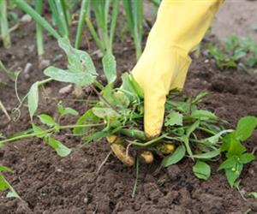
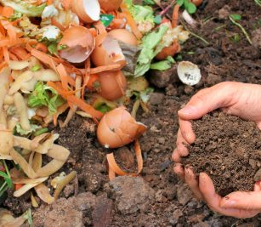
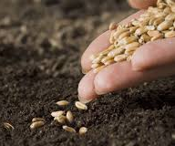
ORGANIZATIONAL INVENTORY
LABEL | MEANING
WEED | What is toxic or crowding out growth
HARVEST | What has grown and bloomed that can be honored and enjoyed
COMPOST | What is no longer useful in its current form but still contained valuable nutrients and can be transformed
SEED | What is not yet present that needs to be planted
WATER | What is in early stages of germination or needs to be tended to and nourished

