Slide 1
Strengths Based Leadership
CompassPoint public workshop
March 24, 2017

Slide 2
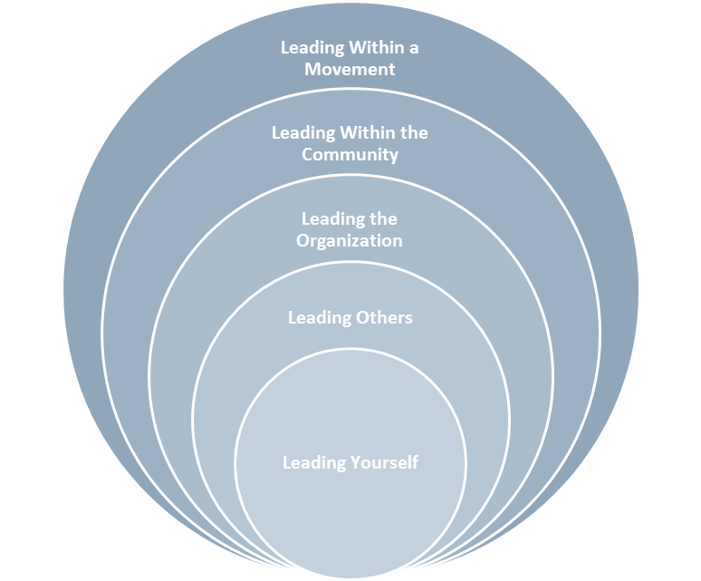
Session Objectives
Understand how to utilize strengths-based leadership principles and practices to further develop in the following domains:
Leading self – understand and become more aware of your personal strengths
Leading with others - create awareness of the strengths of others, enhance interpersonal relationships, supervision and teams
Leading the organization - discuss the skills, systems, and cultural dimensions needed in a strengths-based organization
Notes:
(10 min) Introduce CompassPoint’s Leadership Framework: in preparation for this section, review the detailed leadership framework from your Leadership Development Program binder (often found in the “Kick Off Retreat” section).
Key ideas to emphasize:
This framework is premised on the idea that leadership is a “process of engaging others to move forward an organizational or community agenda, rather than a position of authority”
The skills needed to lead effectively are different depending on what leadership domain you’re leading from
(5 min) Review the session objectives and connect with the 3 leadership domains that will be explored

Slide 3
Group Agreements
Be fully present
Stretch out of your comfort zone
Step up, step back
Find your own voice
Observe confidentiality
Bring heart, not just mind

Slide 4
Our Deepest Fear By Marianne Williamson
Our deepest fear is not that we are inadequate. Our deepest fear is that we are powerful beyond measure. It is our light, not our darkness That most frightens us.
We ask ourselves Who am I to be brilliant, gorgeous, talented, fabulous? Actually, who are you not to be?
. . . as we let our own light shine, We unconsciously give other people permission to do the same. As we're liberated from our own fear, Our presence automatically liberates others.

Slide 5
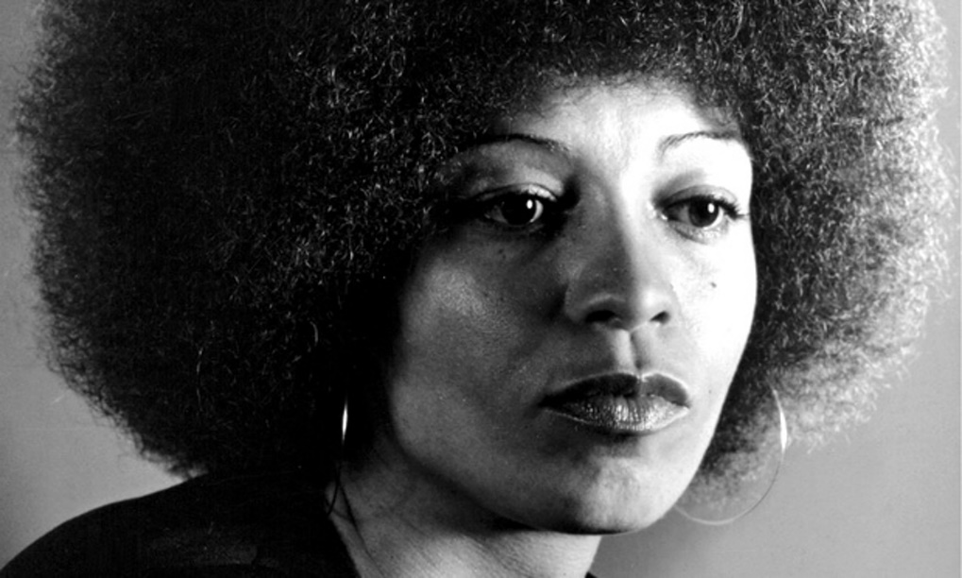
Theory Behind Practice
“Treasure ways of thinking more than the facts you have accumulated. Facts will be presented to you in such a way as to veil the ways of thinking embedded in them. To reveal these hidden ways of thinking, to suggest alternative frameworks, to imagine better ways of living in evolving worlds, to imagine new human relations that are freed from persisting hierarchies, whether they be racial or sexual or geopolitical—this is the work of educated human beings. Education is the practice of freedom.”
—Angela Davis

Slide 6
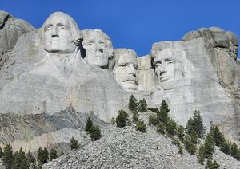
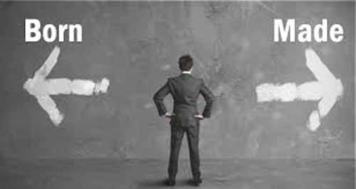
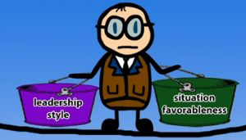
What Makes a Leader? History of Leadership Theories
Great Man
Trait
Behavior
Contingency
Men destined by birth to lead; no women, few POC, and no other way.
Identify leadership traits and find people with these.
Make leaders by teaching “leader-like” behaviors.
Match the leadership style to the situation.
1840s
1930s
1940s
1960s
Notes:
Born not made

Slide 7
Culture Shifts in Leadership (adapted from Catalyst Project (http://collectiveliberation.org/culture-shifts-2/)
SHIFT FROM: |  | SHIFT TOWARD:
Deficit-based thinking | ==> | Strengths-based thinking
Individual focus | ==> | Collective action
Critiquing from the sidelines | ==> | Leading from the center
Obsession With Productivity | ==> | Whole people/whole movements
Notes:
(5 min) Cultural Shifts in Leadership
We think that white anti-racist organizing requires that we move away from competitive, individualist thinking, and instead support as many people as we can to be effective change agents, working in accountable relationships with people of color-led organizations. These shifts in organizing culture help create more sustainable and vibrant movements to win transformative change.
The tendencies in the “Shift From” column produce individuals whose primary concern is being the quickest to critique everything—a practice often encouraged within higher education that fosters distancing or dismissal of people or practices. This practice tends to feed ego, not justice.
We cultivate the “Shift Towards” qualities in order to become bold, grounded leaders who look for opportunities, seek growth for themselves and their communities, and are committed to building the leadership of more people.

Slide 8
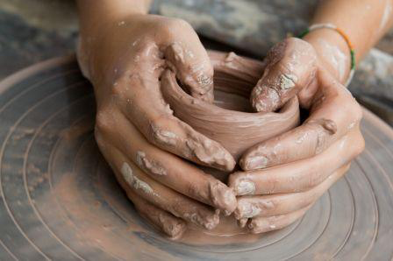
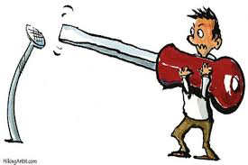
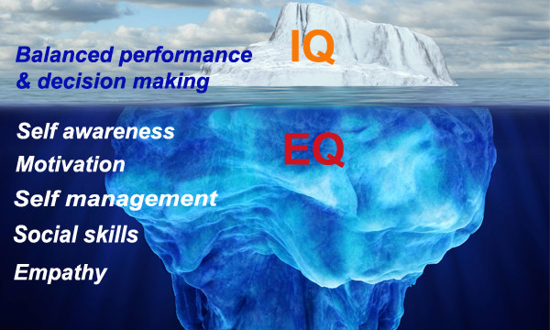
Strengths-Based Leadership
Born AND Made
Talent x (Knowledge + Skill) = Strength
Right strength for the job
Strategy? Influence? Execute? Relationship?
Well-rounded team vs. “Great Man”
. . . possibilities for equity

Slide 9
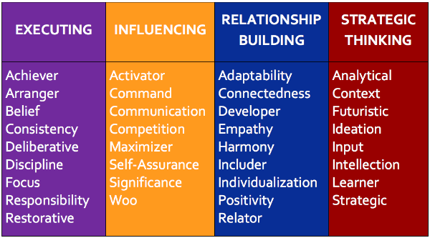
Strengths Envy?

Slide 10
Domains of Leadership Strength
Present-Oriented
Executing | Relationship Building
Strategic Thinking | Influencing
Task-Oriented
People-Oriented
Future-Oriented

Slide 11
“A leader needs to know their strengths as a carpenter knows their tools, or as a physician knows the instruments at her disposal. What great leaders have in common is that each truly knows their strengths – and can call on the right strength at the right time. This explains why there is no definitive list of characteristics that describes all leaders.”
Donald O. Clifton, Gallup Researcher
and Founder of Strengths Psychology

Slide 12
Key Findings from 50 Years of Gallup Research (Rath & Conchie, 2008)
“All too often, leaders are blind to the obvious when it comes to something of critical importance to them – their own personality.”
Rath & Conchie, 2008, p. 11
The most effective leaders:
Are always investing in strengths
Surround themselves with the right people and then maximize their team
Understand their followers needs
Notes:
They studied more than 1 million work teams, conducted more than 20,000 in-depth interviews with leaders, and even interviewed more than 10,000 followers around the world to ask exactly why they followed the most important leader in their life.

Slide 13
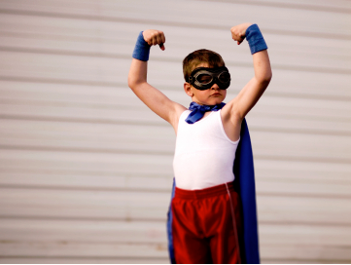
Focusing on Talents & Strengths
Confidence
Engagement in work
Productivity
Individual growth
Career satisfaction
Staff retention
Organizational growth
Notes:
(5 min) Describe what the Strengthsfinder Assessment is
(15 min) Talent Themes
Describe what a talent theme is
Review the 32 talent themes (highlighting 4 to 6 diverse themes as a way to explain what themes are – be prepared to share examples of how those themes may show up in someone’s organization role
(10 min) What is a Strength?
Review the strengths formula form the manual
Use a concrete example re. how a talent theme becomes a strength
For example: “I have an Intellection theme and call on it quite a bit in the leadership program design and delivery work that I do. Recently, I’ve wanted to develop more effective curriculum around innovation and network leadership. To that end, I use my Intellection theme to curate various frameworks, articles and books on those topics (knowledge). I then build my skills by taking design thinking and network mapping workshops so I can understand the content better from a participant perspective. This helps me build more interactive and effective participant learning experiences.”

Slide 14
What is a Strength?
A strength is composed of:
Talents – how we naturally think, feel, and behave.
Knowledge – what you know, does not naturally exist;
Skills – abilities, do not naturally exist within us;
Talent x
(Knowledge + Skill) = Strength

Slide 15
Potential Indicators of Natural Talent
Where do you learn quickly?
When do you lose track of time?
What comes easy or naturally for you?
When you were a child, what did you love to do?

Slide 16
Curiosity Interview
Since childhood, what have you always loved doing?
Tomorrow at work if you could spend time on anything you wanted, what would it be?
What was a peak experience when you felt that you were at your best or most engaged?
Write down any qualities, values, or talents you notice in your partner’s answers.

Slide 17
Curiosity Interview (con’t)
Pair up with your same partner from the curiosity interview:
What was affirmed?
What surprised you?
How did it feel?
What did you learn about yourself in this activity?
Briefly explain your 5 talents from StrengthsFinder. Did these show up in your story? If so, where and how?

Slide 18
StrengthsFinder Assessment

Slide 19
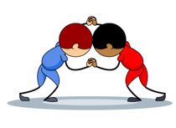
Wrestle with your results . . .
Read and underline what resonates
Cross out what doesn’t
Change words if you want, make it feel right
Be open to surprises and watch out for the inner critic
Land in a picture of your 5 themes that explores the interconnections between themes
And one phrase that capture the overall feel of your talents in your own words

Slide 20
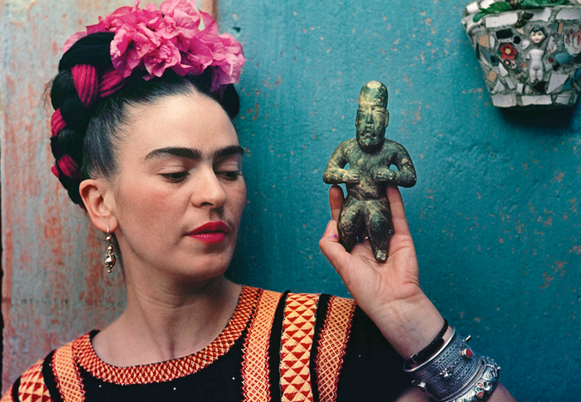
Talent x (Knowledge + Skill) = Strength

Slide 21
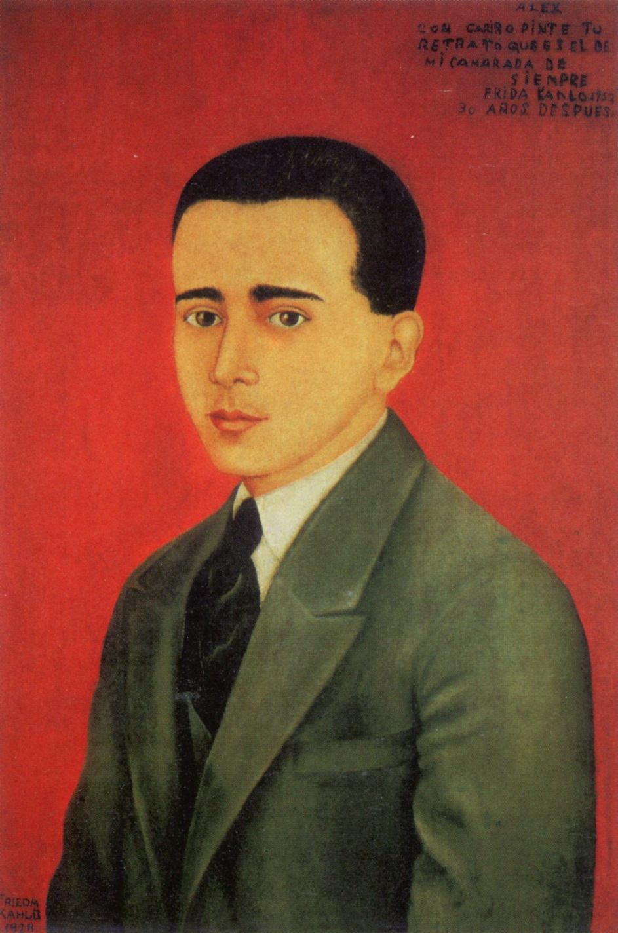
What is a strength?
Notes:
Portrait of Alejandro Gómez Arias. 1928.
This painting is a portrait of Frida's boyfriend Alejandro Arias. It is painted in a conventional portrait style similar to that of a photograph…a sharp contrast to the Renaissance style of her previous portraits. The legend in the upper right corner of the painting reads: "Alex, with affection I painted your portrait, that he is one of my comrades forever, Frida Kahlo, 30 years later". In 1922, Frida began classes at the National Prep School in Mexico City. There she met and fell in love with Alejandro Gómez Arias. For three years they were inseparable. Alex, as Frida called him, was with her on that rainy September afternoon in 1925 when the bus they were riding was struck by a trolley. Alejandro was not seriously injured and it was he who convinced the doctors at the Red Cross Hospital to attend to Frida after they had left her thinking she was too seriously injured to ever survive. Without his persistence Frida probably would have died. While recovering from the accident, Frida wrote countless letters to Alex. In her letters she complained about the pain and about being bedridden, asking him sometimes, "what is going to happen in 30 years", or "how am I going to be when I am 30". Frida and Alex separated in June of 1928 and Frida quickly turned her attention towards Diego Rivera.

Slide 22
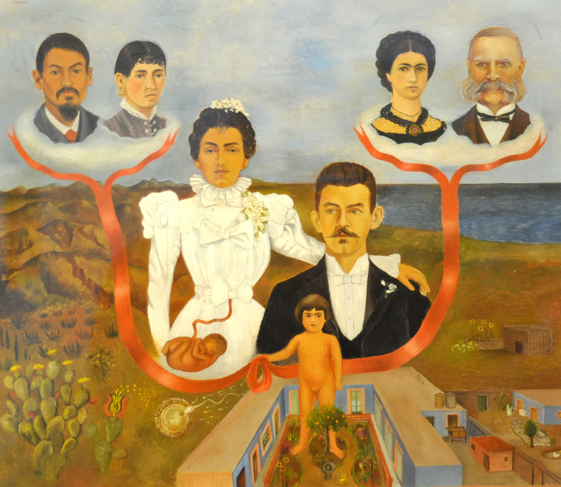
Notes:
My Grandparents, My Parents and Me
1936
This is the first of two family portraits in which Frida was tracing the history of her ancestry. She appears as a little girl in the courtyard of the Blue House in Coyoacan, Mexico, where she was born. Her parents are behind her, in a pose taken from their wedding photograph taken in 1898. The fetus in her mother's womb is Frida before birth and below she painted the fertilization of an egg indicating the very beginning of her life at conception. Frida holds a red ribbon that leads to her Grandparents. Her maternal Grandparents are to the left over the mountainous Mexican landscape and a nopal cactus, which is in symbolic form on the Mexican flag. Her father's parents, of German ancestry, are positioned over the sea, which indicates their European origin.
In this painting, Frida paints herself with her signature single eyebrow, which it appears she inherited from her father's mother.

Slide 23
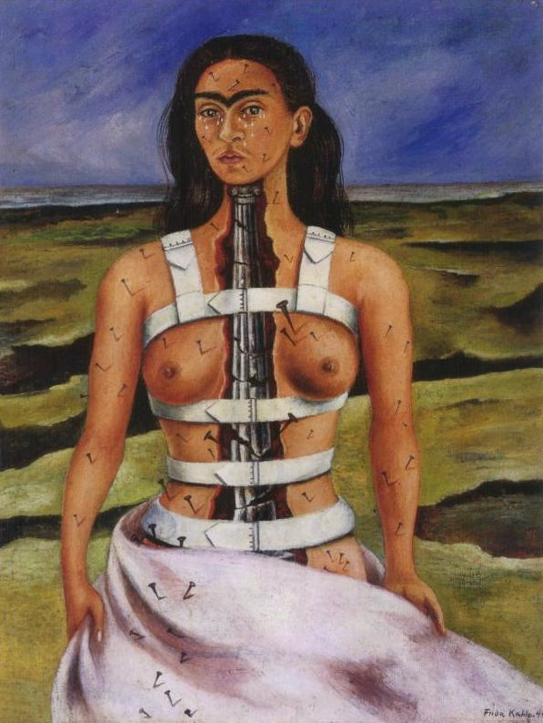
Notes:
The Broken Column, 1944
Pain and suffering is a constant topic in Frida's painting. In this painting, The Broken Column, Frida expressed her anguish and suffering in a most straightforward and horrifying way. The nails are stuck into her face and whole body. A split in her torso which looks like an earthquake fissure. In the background is the earth with dark ravines. At the beginning she paint herself nude but later covered her lower part up with something looks like a hospital sheet. A broken column is put in place of her spine. The column appears to be on the verge of collapsing into rubble. Penetrating from loins to chin, the column looks phallic, and the sexual connotation is all the more obvious because of the beauty of Frida's breasts and torso. This painting Frida looks pretty and strong. Although her whole body is supported by the corset, she is conveying a message of spiritual triumph. She has tears on her face but she look straight ahead and is challenging both herself and her audience to face her situation. The style of this painting is very unique. She laid down each stoke firmly to build a simple and clear image. There are no virtuoso flourishes of the brush and the colors are as neatly contained within contours.

Slide 24
Weakness?
Notes:
Huge caveat to strengths: Not OK to only focus on what you like.
Just as critical to understanding and investing in strengths is the need to understand and manage for areas of weakness.
Areas of weakness are things that are depleting, are frustrating, burn us out, make us defensive or lack confidence, are areas of slow learning.
Don’t always have option to stop doing things that don’t play to our strengths.
Must determine if it is a skills, knowledge, or talent weakness.
Strategies:
Get just good enough
Find a partner or support system
Use a strength to compensate
Stop doing
Note: be prepared to share a story of a weakness you have, how you assessed it (was it skills, knowledge or talent) and what strategy you employed to address the weakness
Warning: Don’t overdo your strengths – they can become a weakness
Example: Activator strength

Slide 25
Strategies for Managing for Weakness
Get good enough; reach a baseline of acceptable performance
Get a support system or partner
Maximize a strength to compensate and overshadow

Slide 26
Supervisor Conversation
When you are the speaker: Answer the following questions. If you were your partner’s supervisee:
How might you want them to
Better communicate with you?
Build a strong relationship?
Understand your motivation?
Approach your professional development?
Recognize your accomplishments?
Discuss how to manage for weakness?
Notes:
(5 min) Introduce Supervision Exercise
Great managers perform their magic by discovering, developing, and celebrating what’s different about each person who works for them.
-How do we identify strengths in those we supervise?
-Do we know what triggers and activates those strengths?
-What about focusing on outcomes to allow people to get there differently?
-Or devising non-traditional ways to help each person grow without necessarily promoting up the “hierarchical” ladder?
Let’s explore implications for working with others by discussing the following questions.
(15 min) Pair exercise
-When you are the speaker
-When you are the listener – Listen as if you were the speaker’s supervisor. Stay open and curious. Ask clarifying questions. Seek to understand.
(10 min) Reflection (debrief)
What did you notice when you were the speaker?
What did you notice when you were the listener?
What surprised you?
What a-ha’s emerged for you?

Slide 27
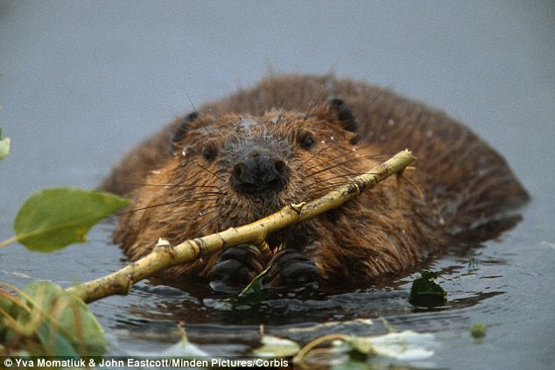
Executing Domain
Know how to make things happen
Have ability to “catch” an idea and make it happen
Notes:
Road Trip Analogy:
Executing Domain person has put together the itinerary and mapped out places to sleep, gas stations, and places to eat. They keep their eye on practical things, like, Do we have enough gas?
Example: One of my co-workers – his reflex is to implement – immediately moves to how to make something happen.

Slide 28
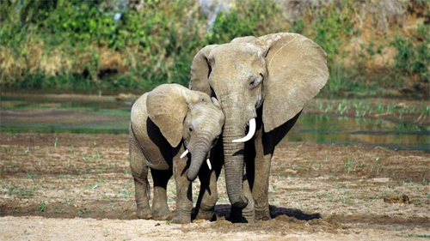
Relationship Building Domain
Provide essential glue that holds the team together
Create groups and organizations that are much greater than the sum of their parts
Notes:
Road Trip Analogy:
RBer looks out for group dynamics: Are people getting along? What can we do so we can all get along better? They usually want to meet everyone’s needs, if possible.
ATJ story
RB group used hearts instead of bullet points <3

Slide 29
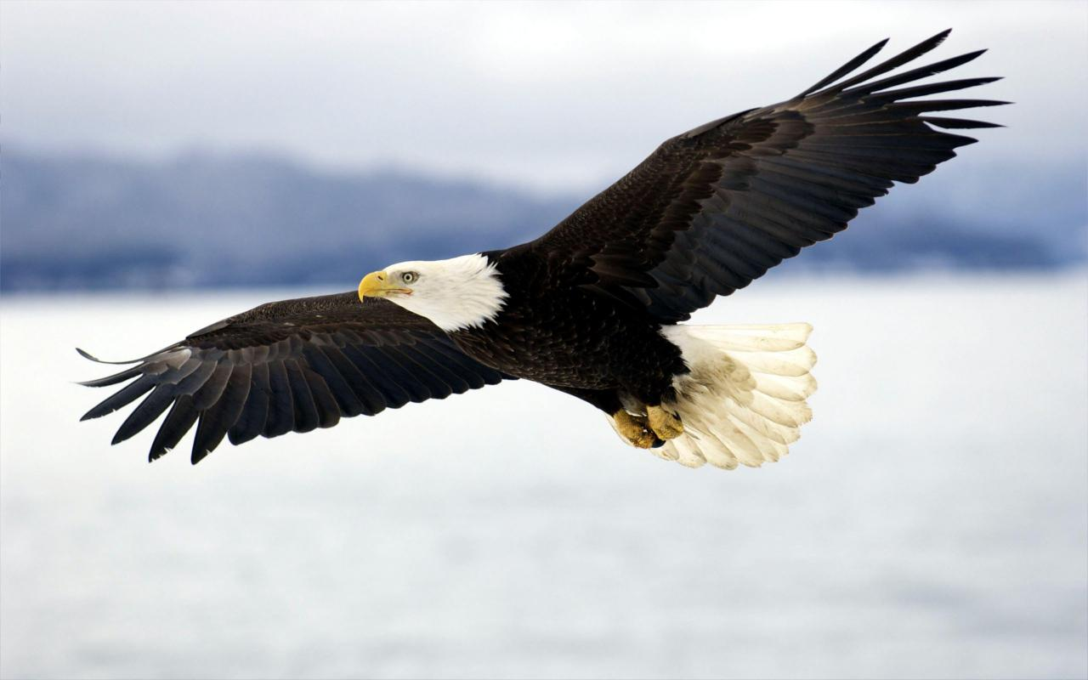
Strategic Thinking Domain
Keep us all focused on what could be
Constantly absorbing and analyzing information and helping the team make better decisions
Notes:
Road Trip Analogy:
Strategic Thinking Domain people tend to think ahead on a big picture level. They usually identify opportunities and challenges, such as: What are the places we must visit? In which areas do we have to watch out for our physical safety?
Able to see far ahead
Instinct is to get to mountaintop rather and look far out before going to the ground.

Slide 30
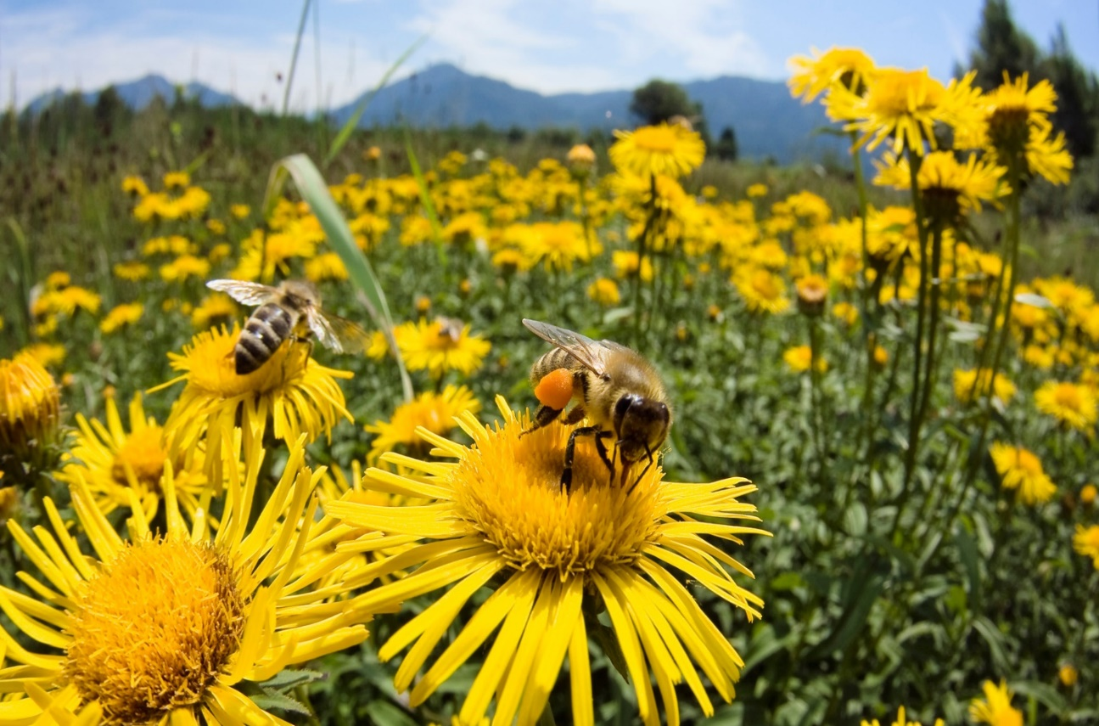
Influencing Domain
Help the team reach a broader audience
Take charge, speak up, and make sure the group is heard
Notes:
Road Trip Analogy:
May advocate for stopping in a certain place.
May want to share road trip adventures with friends via social media.
Reflex:
What are we moving that’s compelling?
How can we change the field?
How can we get our team’s vision and voice heard externally?

Slide 32
Team Strengths
EXECUTING | sujin | Lupe | Kad | Maro
Achiever
Arranger
Belief |  | ■
Consistency
Deliberative
Discipline
Focus
Responsibility |  | ■
Restorative |  | ■
RELATIONSHIP BUILDING | sujin | Lupe | Kad | Maro
Adaptability |  |  |  | ■
Developer |  | ■
Connectedness |  |  | ■
Empathy
Harmony
Includer
Individualization | ■
Positivity
Relator
INFLUENCING | sujin | Lupe | Kad | Maro
Activator | ■
Command
Communication | ■
Competition
Maximizer | ■
Self-Assurance
Significance
Woo
STRATEGIC THINKING | sujin | Lupe | Kad | Maro
Analytical
Context
Futuristic
Ideation | ■ |  | ■ | ■
Input |  |  | ■ | ■
Intellection |  |  | ■ | ■
Learner |  | ■ | ■ | ■
Strategic
While no one individual is ideally well rounded, the best teams are.

Slide 33
Human Options & StrongField Project
Notes:
Maricela Rios-Faust of Human Options in Orange County is using strengths to build an intentional culture of learning and growth in her organization. in 1981.
After participating in the first cohort of Strong Field Project, Rios-Faust organized a half-day retreat for her agency’s supervisors and directors where everyone completed the leadership life map and StrengthsFinder assessment. “That was a transformative experience for a lot of people, and then we took it to the entire staff,” she said. “We have had a fair amount of turnover because we are trying to align strengths with the job descriptions of various positions. For example, we had one person doing human resources and finance, and we recognized that those jobs require entirely different strengths and skillsets. Now we have separated those positions and we have two phenomenal people who are perfect in each one.”
Rios-Faust added: “Working on strengths has re-grounded me in what is important to me: learning and developing people and making sure everyone is in the seat they need to be in to make our agency successful. I have found there are ways to use my relator strength and my developer strength to try and bring people along at a pace that works for everyone.

Slide 34
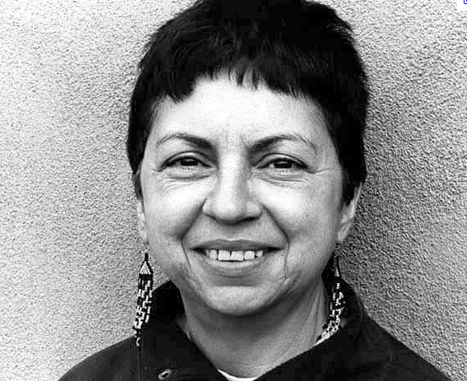
Closing Reflections
I had to leave home so I could find myself, find my own intrinsic nature buried under the personality that had been imposed on me.
-Gloria Anzaldua

